Slide 1
20231010脂蛋白
报告人 许荣仁

Slide 2
主要议程
病人划分
特征降维-效果
特征降维-分析

Slide 3
病人划分
01

Slide 4
病人划分
目的
  将病人划分为不同的组，以此为分类的目标
方法
  CEC-cluster

Slide 5
特征降维-效果
02

Slide 6
特征降维
feature_type | feature | pca
pearson | 27730 | 42
spearman | 27730 | 42
mic | 27730 | 42
moleF | 2124 | 42
self_pearson | 236 | 42
self_spearman | 236 | 42
self_mic | 236 | 42
protein_function | 216 | 42

Slide 7
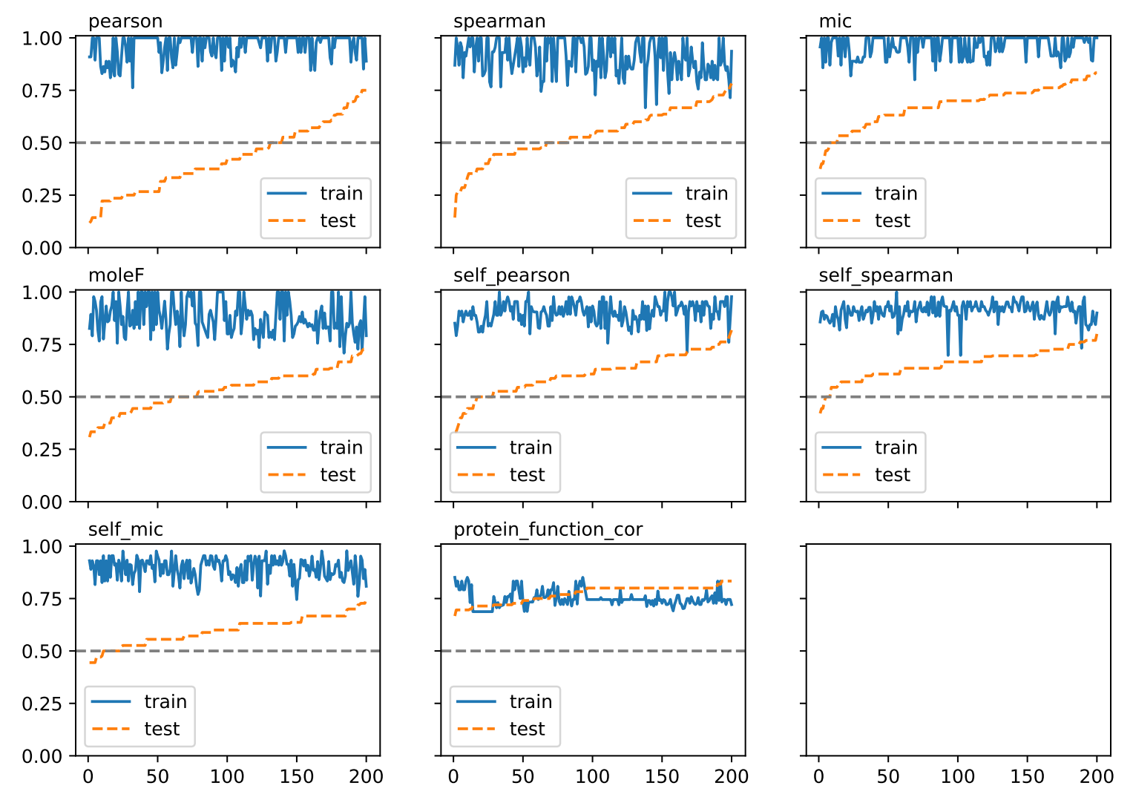
PCA

Slide 8
PCA
cor_type | classifier | f1_train | f1_test
pearson | Logistic | 1 | 0.631579
pearson | SVC | 1 | 0.666667
spearman | Logistic | 1 | 0.444444
spearman | SVC | 1 | 0.526316
mic | Logistic | 1 | 0.736842
mic | SVC | 1 | 0.818182
moleF | Logistic | 1 | 0.5
moleF | SVC | 1 | 0.5
self_pearson | Logistic | 1 | 0.526316
self_pearson | SVC | 1 | 0.555556
self_spearman | Logistic | 0.976744 | 0.727273
self_spearman | SVC | 0.976744 | 0.695652
self_mic | Logistic | 0.977778 | 0.588235
self_mic | SVC | 0.976744 | 0.588235
protein_function_cor | Logistic | 0.808511 | 0.7
protein_function_cor | SVC | 0.808511 | 0.727273

Slide 9
特征降维-分析
03

Slide 10
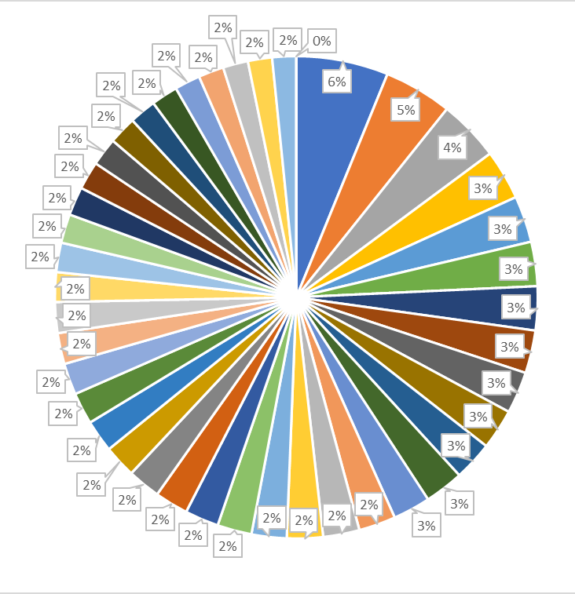
mic pca
保留的20个pca x
feature | 0th | 1st | 2nd | 3rd | 4th | 5th | 6th | 7th | 8th | 9th
pca0 | 0.024988 | 0.023911 | 0.023696 | 0.023658 | 0.023614 | 0.023422 | 0.023314 | 0.023199 | 0.023004 | 0.022816
pca1 | 0.034461 | 0.034295 | 0.03332 | 0.033037 | 0.03276 | 0.032732 | 0.032548 | 0.031442 | 0.031194 | 0.030684
pca2 | 0.031414 | 0.031243 | 0.03118 | 0.030176 | 0.029388 | 0.029353 | 0.029279 | 0.028944 | 0.028445 | 0.028396
pca3 | 0.026431 | 0.026024 | 0.024971 | 0.02496 | 0.024397 | 0.024295 | 0.024228 | 0.023867 | 0.023841 | -0.02371
pca4 | 0.031175 | 0.028451 | 0.027894 | 0.026413 | -0.02483 | 0.024815 | 0.02472 | 0.024661 | 0.024532 | 0.024258
APOM & SM 42:3;3
VTN & PC(16:0/18:1)
APOL1 & PC(16:0/18:1)
RBP4 & TG50:2-FA18:2
HGFAC & SM 42:3;3
BCHE & SM 34:2;2
LUM & SM 44:0;3
PON1 & SM 42:3;3
APOC3 & SM 38:1;2
ACTB & SM 42:3;3

Slide 11
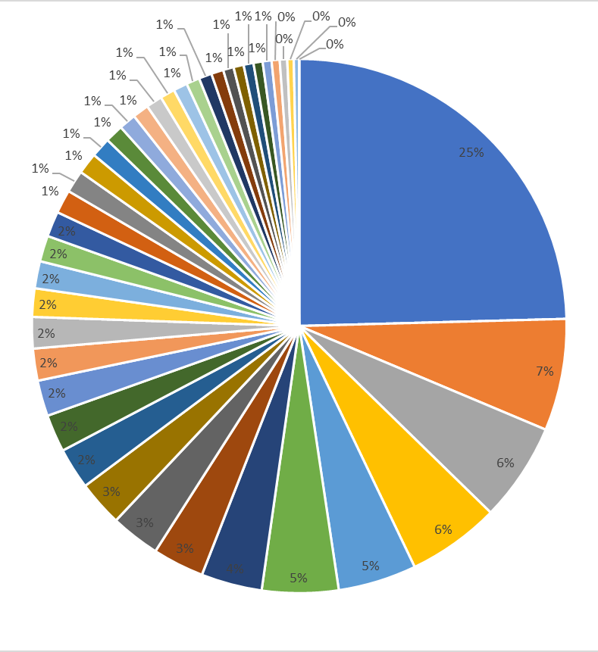
self_spearman pca
feature | 0th | 1st | 2nd | 3rd | 4th | 5th | 6th | 7th | 8th | 9th
pca0 | -0.14586 | -0.14293 | -0.14199 | -0.14191 | -0.13771 | -0.13744 | -0.13668 | -0.13649 | -0.13549 | -0.13462
pca1 | -0.20442 | -0.20039 | -0.19915 | -0.19706 | -0.19429 | -0.18347 | -0.18308 | -0.1802 | -0.17255 | -0.17124
pca2 | 0.177739 | 0.176669 | 0.169441 | 0.163916 | 0.160835 | 0.157403 | 0.154338 | 0.144925 | 0.141701 | 0.140686
pca3 | -0.24754 | -0.24421 | -0.20081 | -0.17734 | 0.172569 | 0.171852 | -0.16259 | -0.14805 | -0.14613 | -0.14419
pca4 | -0.19422 | 0.186745 | -0.17322 | -0.16805 | 0.167664 | 0.162153 | 0.160705 | 0.158747 | 0.148829 | -0.14429
SM 44:3;2
LPC(16:0)
SM 44:3;3
SM 38:0;2
SM 34:2;2
SM 44:0;3
SM 36:0;2
SM 42:3;2
SM 40:1;3
SM 36:1;3
保留的20个pca x

Slide 12
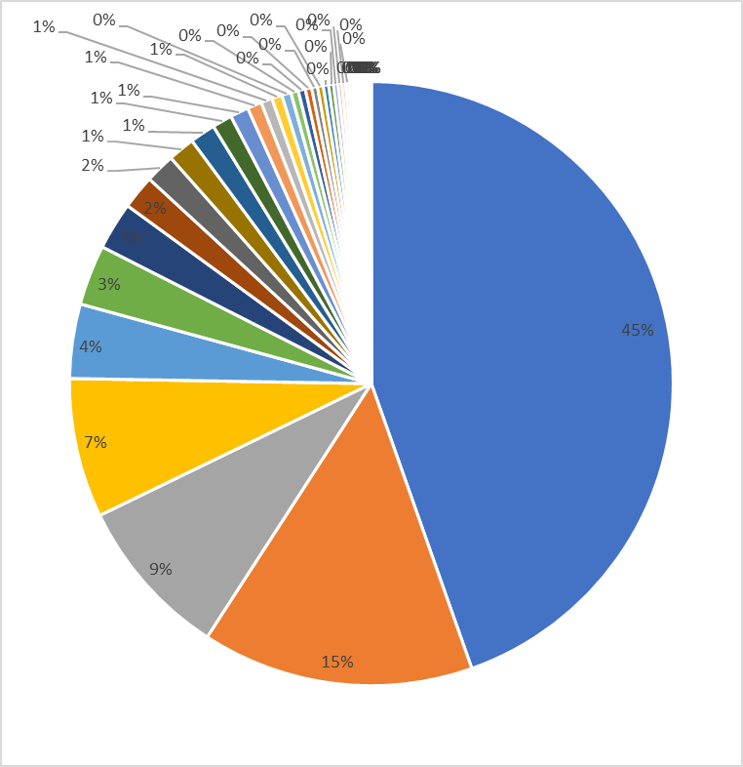
protein_function pca
保留的20个pca x
feature | 0th | 1st | 2nd | 3rd | 4th | 5th | 6th | 7th | 8th | 9th
pca0 | 0.204672 | 0.178592 | 0.164598 | 0.162287 | 0.155516 | 0.154055 | 0.148662 | 0.145936 | 0.145437 | 0.144516
pca1 | -0.2725 | -0.25358 | -0.2346 | -0.23053 | 0.217477 | -0.2055 | -0.19653 | -0.18861 | -0.18031 | -0.17268
pca2 | -0.24614 | -0.23644 | -0.22286 | -0.18912 | -0.18696 | -0.185 | -0.18192 | -0.17234 | 0.159309 | -0.15682
pca3 | -0.29509 | -0.25903 | 0.235519 | -0.23049 | -0.21072 | -0.18357 | -0.18003 | -0.15509 | 0.132387 | -0.13097
pca4 | 0.280759 | 0.239037 | 0.226434 | 0.20011 | 0.193987 | 0.182717 | 0.158849 | 0.156116 | -0.14975 | -0.14627
F1&9_Cell/Heparin Binding
F1&9_Hemostasis/Protease Inhibition
F1&7_Cell/Heparin Binding
F1&6_Cell/Heparin Binding
F2&9_Cell/Heparin Binding
F1&9_other
F1&9_Immunity/Anti-microbial
F3&7_Cell/Heparin Binding
F2&6_Cell/Heparin Binding
F2&7_Cell/Heparin Binding

Slide 13
谢谢！

