Slide 1
20231020脂蛋白
报告人 许荣仁

Slide 2
主要议程
病人划分
特征降维-效果
特征降维-分析

Slide 3
病人划分
01

Slide 4
病人划分
目的
  将病人划分为不同的组，以此为分类的目标
方法
  CEC-cluster

Slide 5
特征降维-效果
02

Slide 6
PCA – 出现最多的20个
cor_type | classifier | f1_train | f1_test
pearson | Logistic | 1 | 0.631579
pearson | SVC | 1 | 0.666667
spearman | Logistic | 1 | 0.444444
spearman | SVC | 1 | 0.526316
mic | Logistic | 1 | 0.736842
mic | SVC | 1 | 0.818182
moleF | Logistic | 1 | 0.5
moleF | SVC | 1 | 0.5
self_pearson | Logistic | 1 | 0.526316
self_pearson | SVC | 1 | 0.555556
self_spearman | Logistic | 0.976744 | 0.727273
self_spearman | SVC | 0.976744 | 0.695652
self_mic | Logistic | 0.977778 | 0.588235
self_mic | SVC | 0.976744 | 0.588235
protein_function_cor | Logistic | 0.808511 | 0.7
protein_function_cor | SVC | 0.808511 | 0.727273

Slide 7
PCA – 占原始数据方差最多的20个
cor_type | classifier | f1_train | f1_test
pearson | LogisticRe | 0.933333 | 0.636364
pearson | SVC(kernel | 0.977778 | 0.636364
spearman | LogisticRe | 1 | 0.631579
spearman | SVC(kernel | 1 | 0.631579
mic | LogisticRe | 0.933333 | 0.6
mic | SVC(kernel | 0.977778 | 0.608696
moleF | LogisticRe | 1 | 0.380952
moleF | SVC(kernel | 1 | 0.380952
self_pearson | LogisticRe | 0.863636 | 0.333333
self_pearson | SVC(kernel | 0.933333 | 0.210526
self_spearman | LogisticRe | 0.888889 | 0.526316
self_spearman | SVC(kernel | 0.888889 | 0.333333
self_mic | LogisticRe | 0.8 | 0.636364
self_mic | SVC(kernel | 0.791667 | 0.666667
protein_function_cor | LogisticRe | 0.75 | 0.857143
protein_function_cor | SVC(kernel | 0.75 | 0.818182

Slide 8
特征降维-分析
03

Slide 9
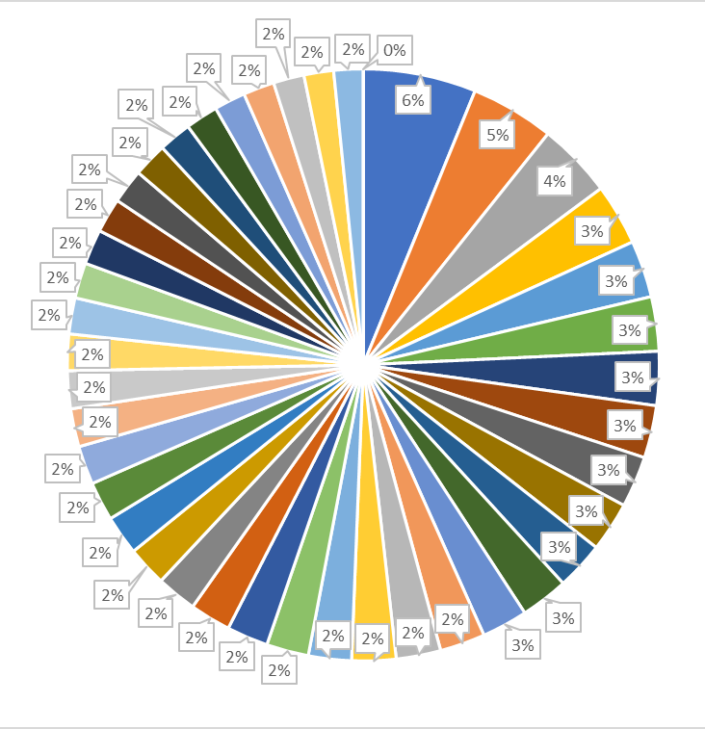
mic pca
[9, 15, 32, 21, 39, 36, 35, 31, 19, 20, 17, 33, 13, 23, 12, 10, 22, 25, 30, 11]
[9, 10, 11, 12, 13, 15, 17, 19, 20, 21, 22, 23, 25, 30, 31, 32, 33, 35, 36, 39]
feature | 0th | 1st | 2nd | 3rd | 4th | 5th | 6th | 7th | 8th | 9th
pca9 | 0.02934 | -0.02862 | 0.02729 | -0.02553 | 0.025425 | -0.02526 | 0.024993 | -0.02446 | 0.024234 | 0.024018
pca15 | 0.02833 | 0.027575 | 0.027536 | -0.02628 | 0.025878 | -0.02582 | -0.02573 | 0.025556 | 0.025395 | -0.02509
pca32 | -0.02629 | -0.02492 | 0.024172 | 0.023766 | -0.02375 | 0.023738 | -0.02318 | 0.023163 | -0.02303 | -0.0229
pca21 | 0.029765 | 0.027944 | 0.027805 | 0.027515 | 0.026523 | 0.025395 | 0.025257 | 0.024773 | 0.024357 | 0.024104
pca39 | 0.031929 | 0.029871 | 0.02952 | 0.028041 | -0.02742 | 0.027024 | 0.025869 | -0.02578 | 0.025753 | 0.025172
APOM & SM 42:3;3
VTN & PC(16:0/18:1)
APOL1 & PC(16:0/18:1)
RBP4 & TG50:2-FA18:2
HGFAC & SM 42:3;3
BCHE & SM 34:2;2
LUM & SM 44:0;3
PON1 & SM 42:3;3
APOC3 & SM 38:1;2
ACTB & SM 42:3;3
SM 40:1;3 & SM 34:2;3
SEPP1 & TTR
SM 42:3;2 & SM 44:3;2
A2M & APOA1
FGA & PON1
CDH5 & SEPP1
SM 40:1;2 & SM 44:3;2
SEPP1 & SERPINC1
APCS & FGA
FGA & ITIH1

Slide 10
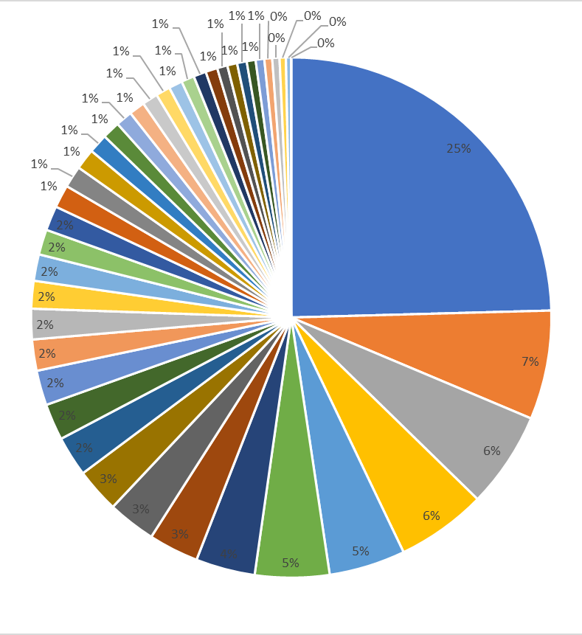
self_spearman pca
[7, 9, 39, 21, 33, 31, 34, 4, 15, 30, 11, 28, 40, 35, 25, 36, 17, 19, 27, 13]
[4, 7, 9, 11, 13, 15, 17, 19, 21, 25, 27, 28, 30, 31, 33, 34, 35, 36, 39, 40]
feature | 0th | 1st | 2nd | 3rd | 4th | 5th | 6th | 7th | 8th | 9th
pca7 | 0.201997 | 0.188449 | -0.18574 | 0.18132 | 0.178247 | 0.174861 | -0.16677 | 0.165277 | 0.161045 | -0.15638
pca9 | -0.30896 | 0.267676 | -0.22261 | -0.21253 | -0.20375 | 0.193287 | -0.18001 | -0.16594 | 0.163038 | -0.15927
pca39 | 0.232896 | -0.17932 | 0.178586 | 0.178045 | 0.169687 | -0.16372 | -0.15754 | 0.154081 | -0.14875 | 0.147232
pca21 | 0.25072 | 0.203624 | 0.201975 | -0.19746 | -0.17387 | -0.16948 | -0.14536 | 0.143345 | 0.140694 | -0.13943
pca33 | -0.30921 | 0.248847 | -0.1818 | -0.17093 | -0.16677 | -0.16452 | 0.150423 | 0.14292 | 0.138962 | -0.13207
SM 44:3;2
LPC(16:0)
SM 44:3;3
SM 38:0;2
SM 34:2;2
SM 44:0;3
SM 36:0;2
SM 42:3;2
SM 40:1;3
SM 36:1;3
APOC3
TG52:0-FA18:0
TG51:4-FA18:2
MBL2
FGA
TG56:3-FA18:1
SM 42:0;2
TG48:0-FA16:0
FN1
PZP
APOC3
KRT2
APOC2
SM 38:3;3
KRT10
KRT5
KRT1
KRT14
KRT9
TG46:1-FA16:0

Slide 11
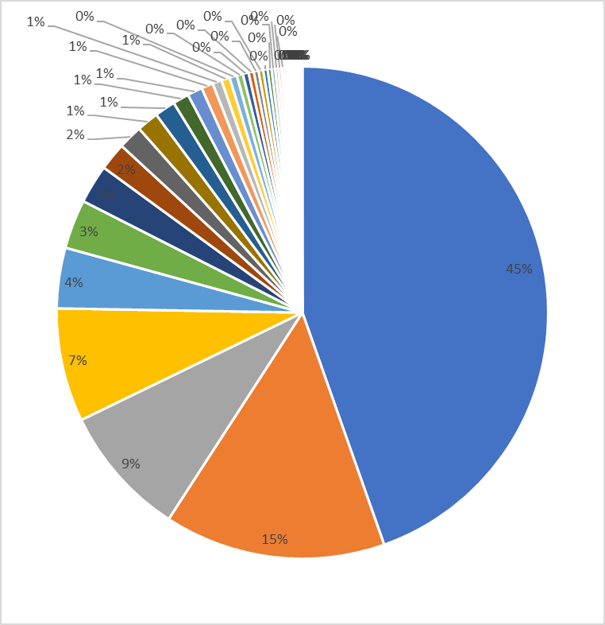
protein_function pca
[7, 12, 9, 21, 10, 13, 1, 17, 15, 22, 26, 31, 3, 19, 16, 14, 38, 24, 8, 37]
[1, 3, 7, 8, 9, 10, 12, 13, 14, 15, 16, 17, 19, 21, 22, 24, 26, 31, 37, 38]
feature | 0th | 1st | 2nd | 3rd | 4th | 5th | 6th | 7th | 8th | 9th
pca7 | -0.26875 | -0.22799 | -0.19742 | -0.19727 | -0.18879 | 0.164093 | 0.162111 | 0.158127 | 0.155063 | 0.148354
pca12 | -0.21072 | -0.17907 | 0.175051 | -0.17071 | -0.16905 | -0.16066 | 0.150999 | -0.14953 | -0.13986 | 0.139756
pca9 | -0.25683 | -0.2352 | -0.22877 | -0.2 | 0.190937 | -0.17616 | 0.172805 | -0.17047 | -0.16854 | 0.162062
pca21 | -0.22067 | 0.205217 | 0.188927 | 0.185349 | 0.169228 | -0.15895 | -0.15826 | 0.155205 | 0.14504 | 0.144901
pca10 | -0.24246 | -0.20575 | 0.201307 | 0.19055 | 0.180423 | 0.176868 | 0.167319 | 0.159733 | 0.159585 | 0.157943
F1&9_Cell/Heparin Binding
F1&9_Hemostasis/Protease Inhibition
F1&7_Cell/Heparin Binding
F1&6_Cell/Heparin Binding
F2&9_Cell/Heparin Binding
F1&9_other
F1&9_Immunity/Anti-microbial
F3&7_Cell/Heparin Binding
F2&6_Cell/Heparin Binding
F2&7_Cell/Heparin Binding
F2&8_Inflammation/Acute Phase
F2&9_Inflammation/Acute Phase
F1&8_Inflammation/Acute Phase
F1&9_Inflammation/Acute Phase
F2&7_Inflammation/Acute Phase
F1&4_Immunity/Anti-microbial
F1&7_Immunity/Anti-microbial
F1&9_Immunity/Anti-microbial
F1&6_Immunity/Anti-microbial
F3&4_Inflammation/Acute Phase

Slide 12
protein_function pca
[7, 12, 9, 21, 10, 13, 1, 17, 15, 22, 26, 31, 3, 19, 16, 14, 38, 24, 8, 37]
[1, 3, 7, 8, 9, 10, 12, 13, 14, 15, 16, 17, 19, 21, 22, 24, 26, 31, 37, 38]
feature | 0th | 1st | 2nd | 3rd | 4th | 5th | 6th | 7th | 8th | 9th
pca7 | -0.26875 | -0.22799 | -0.19742 | -0.19727 | -0.18879 | 0.164093 | 0.162111 | 0.158127 | 0.155063 | 0.148354
pca12 | -0.21072 | -0.17907 | 0.175051 | -0.17071 | -0.16905 | -0.16066 | 0.150999 | -0.14953 | -0.13986 | 0.139756
pca9 | -0.25683 | -0.2352 | -0.22877 | -0.2 | 0.190937 | -0.17616 | 0.172805 | -0.17047 | -0.16854 | 0.162062
pca21 | -0.22067 | 0.205217 | 0.188927 | 0.185349 | 0.169228 | -0.15895 | -0.15826 | 0.155205 | 0.14504 | 0.144901
pca10 | -0.24246 | -0.20575 | 0.201307 | 0.19055 | 0.180423 | 0.176868 | 0.167319 | 0.159733 | 0.159585 | 0.157943
F1&9_Cell/Heparin Binding
F1&9_Hemostasis/Protease Inhibition
F1&7_Cell/Heparin Binding
F1&6_Cell/Heparin Binding
F2&9_Cell/Heparin Binding
F1&9_other
F1&9_Immunity/Anti-microbial
F3&7_Cell/Heparin Binding
F2&6_Cell/Heparin Binding
F2&7_Cell/Heparin Binding
F1&8_Cell/Heparin Binding
F1&6_Cell/Heparin Binding
F1&5_Cell/Heparin Binding
F1&7_Cell/Heparin Binding
F1&9_Hemostasis/Protease Inhibition
F2&8_Cell/Heparin Binding
F1&4_Cell/Heparin Binding
F8&9_Cell/Heparin Binding
F2&6_Cell/Heparin Binding
F4&9_Cell/Heparin Binding

Slide 13
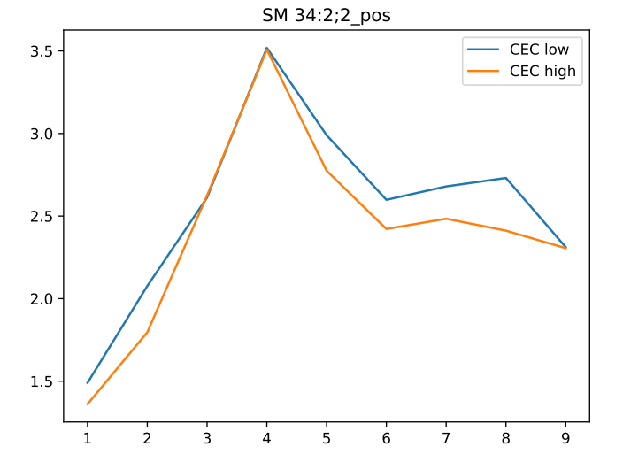
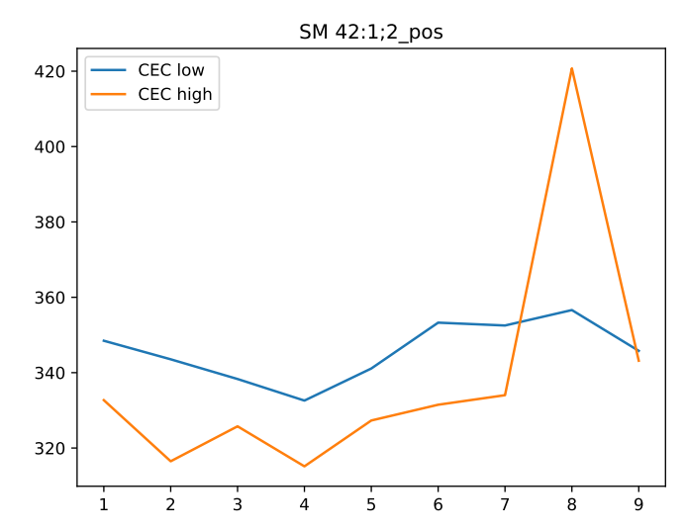
两组分布

Slide 14
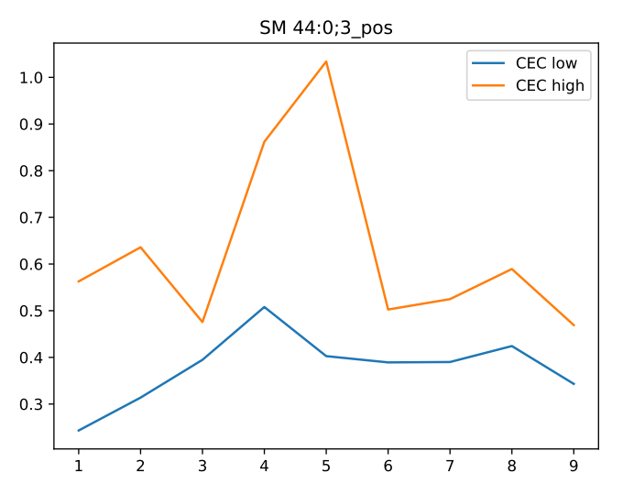
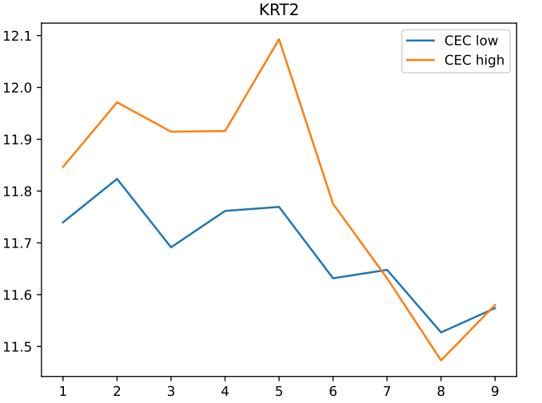
两组分布

Slide 15
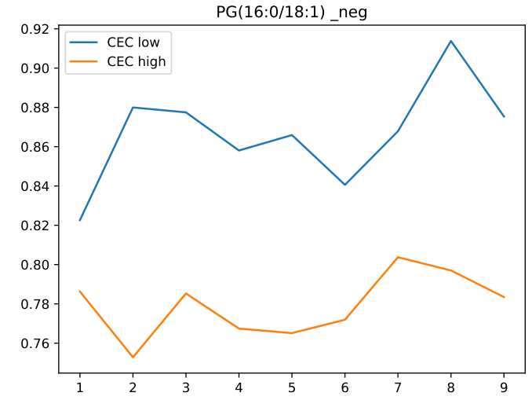
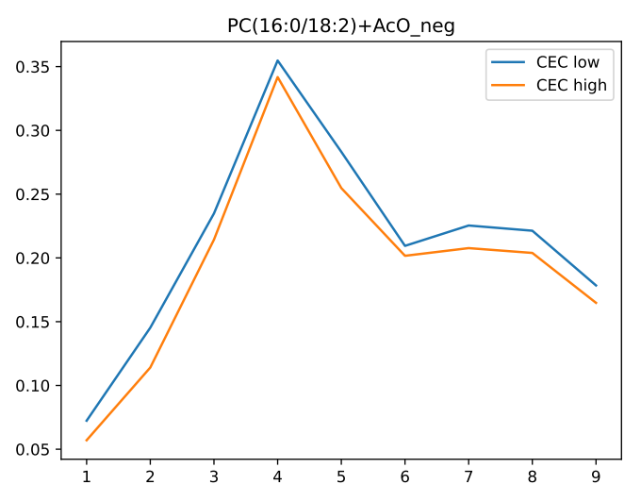
两组分布

Slide 16
谢谢！

