Slide 1



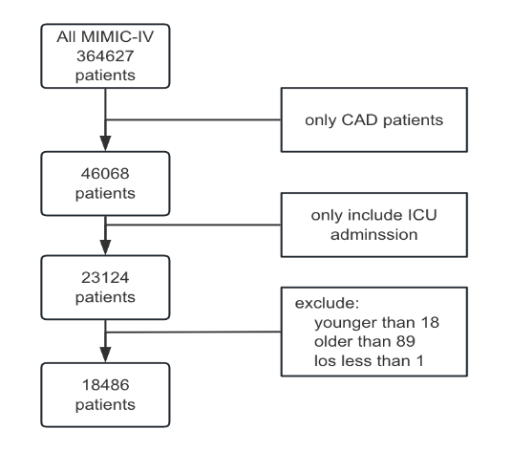
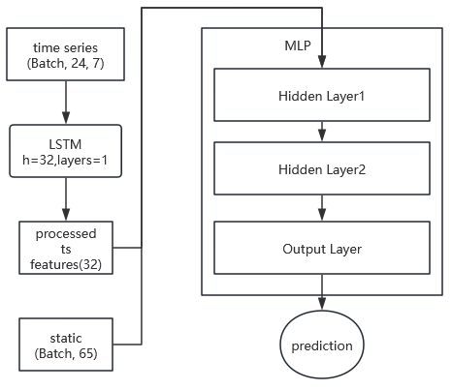
2025 19th International Conference on Complex Medical Engineering
August 1-3, 2025|Lanzhou, China
A fusion method combining LSTM and MLP for predicting the risk of death in patients admitted to the ICU for coronary artery disease
Rongren Xu, Haoran Zheng*
School of Computer Science and Technology, University of Science and Technology of China
Introduction
CAD represents a primary cause of global morbidity and mortality. Within critical care settings, its acute manifestation, ACS, carries a particularly high mortality rate, with in-hospital deaths exceeding 5% and potentially reaching 26.7% in high-risk subgroups. A significant challenge in managing these critically ill patients is the accurate and timely assessment of their prognosis. While numerous risk factors, from demographic data to biomarkers such as the TyG index, HGI, and NLR, have been identified, effectively integrating these scattered static indicators with patients' continuous physiological dynamics remains a major hurdle in clinical practice.
Clinical decision-making has relied on traditional scoring systems such as GRACE, TIMI, and SOFA. This static nature frequently results in suboptimal predictive performance in heterogeneous patient populations.
To bridge this gap, this study proposes a novel, end-to-end deep learning model to predict 30-day mortality in CAD patients admitted to the ICU. We designed a fusion architecture that integrates a Long Short-Term Memory (LSTM) network with a Multi-Layer Perceptron (MLP). By capturing complex temporal patterns through the LSTM while integrating baseline context via the MLP, our model aims to learn a more comprehensive and dynamic representation of patient risk, thereby improving the accuracy of mortality prediction in this critical patient cohort.
Material & Method
Results
We identified adult patients diagnosed with CAD from MIMIC-IV database.
Data were extracted from the first 24 hours of each patient's ICU stay. The features were categorized into two types: static baseline features and time-series features.
we propose an end-to-end model composed of an LSTM module for dynamic
We compared some baseline characteristics of patients with different outcomes.
Several key differences were observed between the two groups. Patients in the mortality group were, on average, older and had a lower body weight compared to the survival group. Clinically, the mortality group exhibited significantly higher severity scores upon admission, as evidenced by higher mean values for SAPS II, OASIS, and LODS. Furthermore, a greater proportion of patients in the mortality group required mechanical ventilation within the first 24 hours of their ICU stay. Demographically, the percentage of female patients was also higher in the mortality group.
Our proposed fusion model demonstrated the highest discriminative ability for predicting 30-day mortality. The LSTM-MLP model achieved a primary evaluation metric, the Area Under the Precision-Recall Curve (AU-PRC) .
data and an MLP module for static data.
We benchmarked our proposed LSTM-MLP model against two categories of baseline models: Clinical Scoring Systems and Traditional Machine Learning Models.
Model | AU-PRC | AU-ROC | Accuracy | F1-Score
Saps ii (best clinical score) | 0.3127 | 0.7505 | 0.7933 | 0.3762
LightGBM (best traditional ML) | 0.5562 | 0.8934 | 0.8856 | 0.5495
LSTM-MLP (our proposed model) | 0.5816 | 0.8995 | 0.8818 | 0.5720
Conclusion
This study successfully developed a deep learning model that fuses an LSTM and an MLP network to predict 30-day mortality for CAD patients in the ICU. By integrating 24-hour dynamic time-series data with static baseline features, our end-to-end model achieved an highest AU-PRC and an highest AU-ROC on an independent test set, significantly outperforming both traditional clinical scores and standard machine learning models.
These results demonstrate that capturing the complex, time-dependent evolution of a patient's condition is critical for accurate risk stratification. While acknowledging the limitations of single-center data and the need for enhanced interpretability, our model's high recall and strong discriminative power establish it as a promising clinical decision support tool, capable of aiding clinicians in the early identification of high-risk individuals to guide timely intervention.

