Slide 1
MIMIC-IV 冠心病汇报
20241212

Slide 2
人群
Cohort
诊断有CAD 46,068
入住ICU 23,124
年龄18~89 18,023
有糖化血红蛋白 2,106
缺失不超10% 1,781

Slide 3
基线信息
baseline
name | all(n=1781) | male(n=1215) | femal(n=566) | p1 | survival365(n=1357) | dead365(n=424) | p2
ami |  |  |  | 0.937097 |  |  | 9.01E-05
No | 1362(76.47%) | 928(76.38%) | 434(76.68%) |  | 1006(74.13%) | 50(78.12%)
Yes | 419(23.53%) | 287(23.62%) | 132(23.32%) |  | 351(25.87%) | 14(21.88%)
acs |  |  |  | 0.19047 |  |  | 0.021435
No | 924(51.88%) | 617(50.78%) | 307(54.24%) |  | 681(50.18%) | 29(45.31%)
Yes | 857(48.12%) | 598(49.22%) | 259(45.76%) |  | 676(49.82%) | 35(54.69%)
gender_male |  |  |  | 0 |  |  | 0.010545
No | 566(31.78%) | 0(0.00%) | 566(100.00%) |  | 408(30.07%) | 19(29.69%)
Yes | 1215(68.22%) | 1215(100.00%) | 0(0.00%) |  | 949(69.93%) | 45(70.31%)
hadm_congestive_heart_failure |  |  |  | 0.275794 |  |  | 6.56E-09
No | 954(53.57%) | 662(54.49%) | 292(51.59%) |  | 781(57.55%) | 31(48.44%)
Yes | 827(46.43%) | 553(45.51%) | 274(48.41%) |  | 576(42.45%) | 33(51.56%)
hadm_cerebrovascular_disease |  |  |  | 1.49E-06 |  |  | 3.45E-14
No | 1228(68.95%) | 882(72.59%) | 346(61.13%) |  | 1000(73.69%) | 42(65.62%)
Yes | 553(31.05%) | 333(27.41%) | 220(38.87%) |  | 357(26.31%) | 22(34.38%)
hadm_dementia |  |  |  | 0.000586 |  |  | 1.36E-08
No | 1718(96.46%) | 1185(97.53%) | 533(94.17%) |  | 1329(97.94%) | 60(93.75%)
Yes | 63(3.54%) | 30(2.47%) | 33(5.83%) |  | 28(2.06%) | 4(6.25%)
hadm_mild_liver_disease |  |  |  | 0.832255 |  |  | 0.009827
No | 1698(95.34%) | 1157(95.23%) | 541(95.58%) |  | 1304(96.09%) | 61(95.31%)
Yes | 83(4.66%) | 58(4.77%) | 25(4.42%) |  | 53(3.91%) | 3(4.69%)
hadm_paraplegia |  |  |  | 0.000202 |  |  | 1.89E-13
No | 1504(84.45%) | 1053(86.67%) | 451(79.68%) |  | 1194(87.99%) | 50(78.12%)
Yes | 277(15.55%) | 162(13.33%) | 115(20.32%) |  | 163(12.01%) | 14(21.88%)
hadm_renal_disease |  |  |  | 0.122155 |  |  | 2.50E-12
No | 1345(75.52%) | 904(74.40%) | 441(77.92%) |  | 1082(79.73%) | 39(60.94%)
Yes | 436(24.48%) | 311(25.60%) | 125(22.08%) |  | 275(20.27%) | 25(39.06%)
hadm_malignant_cancer |  |  |  | 0.77419 |  |  | 5.75E-11
No | 1697(95.28%) | 1156(95.14%) | 541(95.58%) |  | 1321(97.35%) | 59(92.19%)
Yes | 84(4.72%) | 59(4.86%) | 25(4.42%) |  | 36(2.65%) | 5(7.81%)
hadm_metastatic_solid_tumor |  |  |  | 0.873219 |  |  | 1.07E-09
No | 1740(97.70%) | 1188(97.78%) | 552(97.53%) |  | 1345(99.12%) | 59(92.19%)
Yes | 41(2.30%) | 27(2.22%) | 14(2.47%) |  | 12(0.88%) | 5(7.81%)

Slide 4
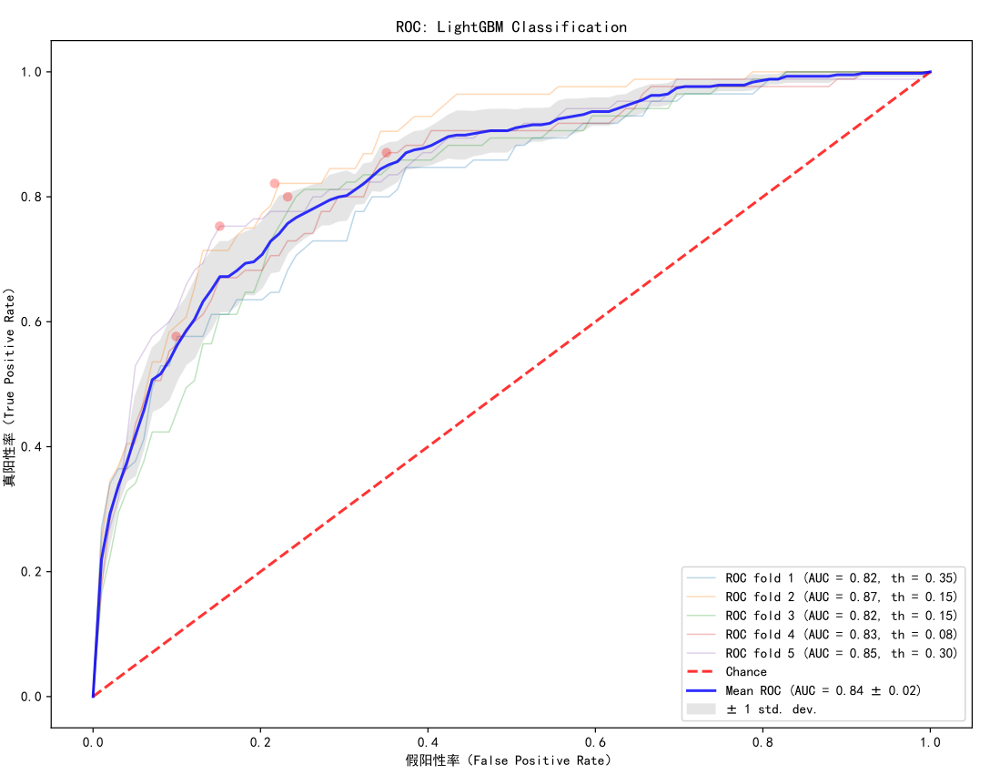
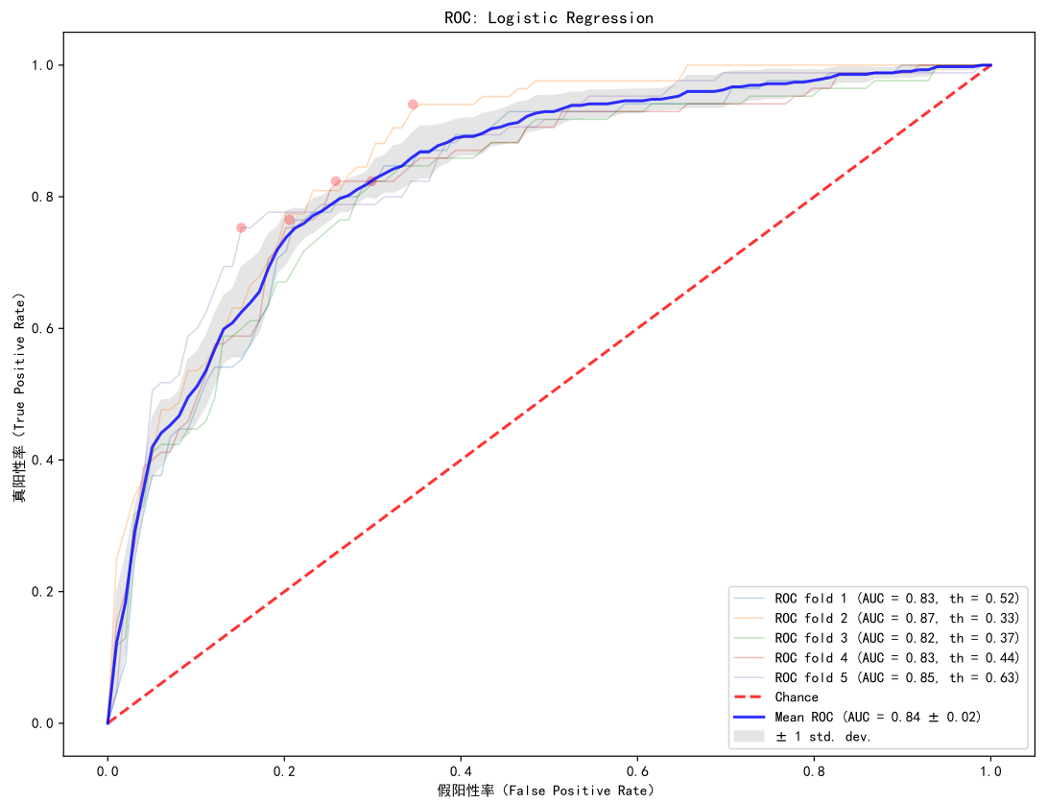
预测比较
comparison without HGI

Slide 5
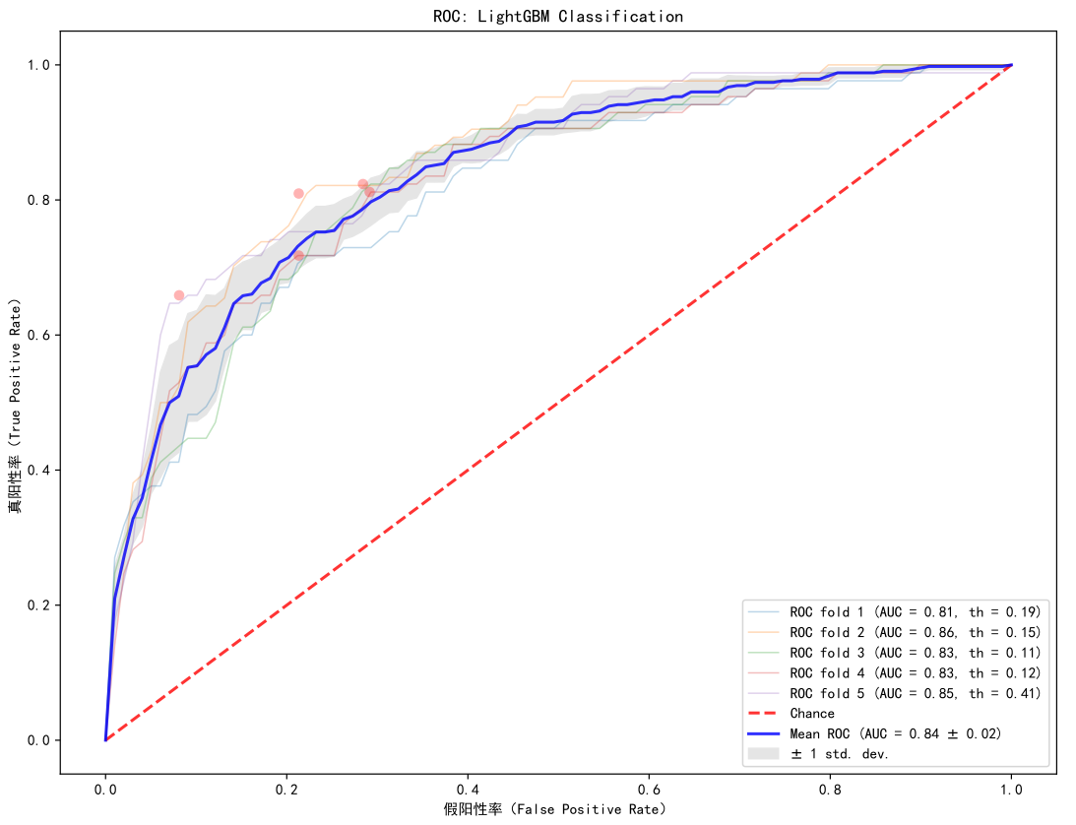
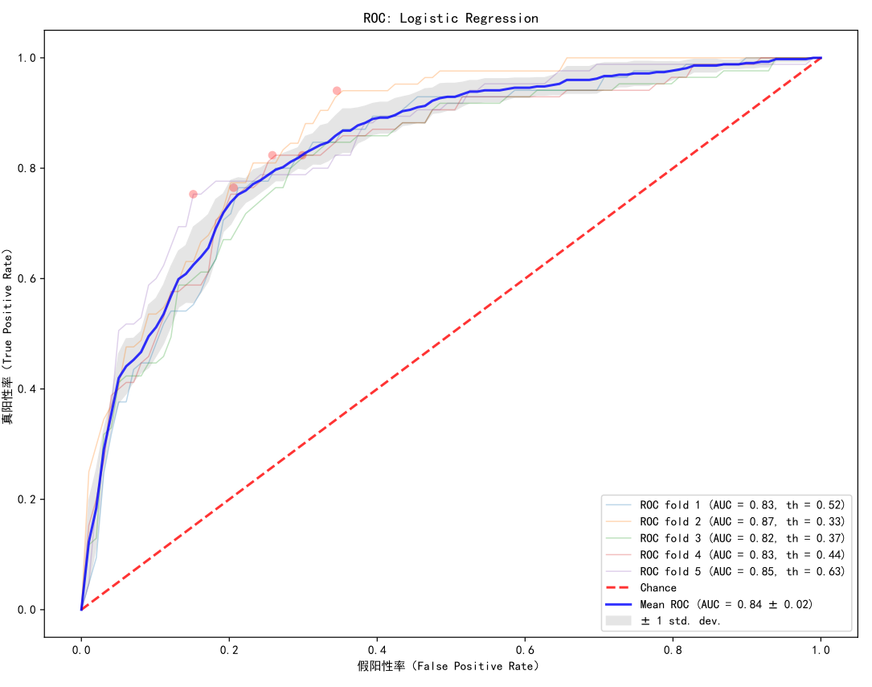
预测比较
comparison with HGI
HGI加入并没有提高预测效果

Slide 6
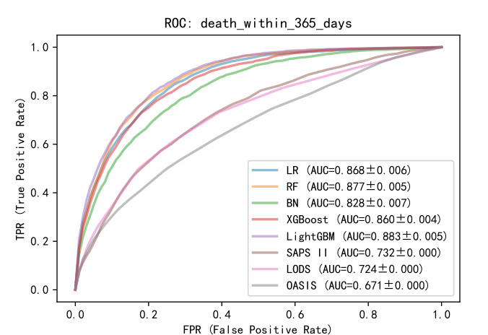
预测比较
comparison
本次数据的效果差于之前数据的效果，样本量差异大

Slide 7
谢谢 ！
请提宝贵意见

