Slide 1
Minimizing Inter-sever Communications in OSN Systems
Presented in ICNP2012
Notes:
‹#›

Slide 2
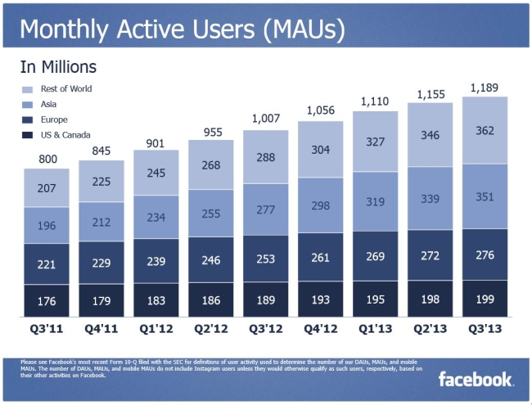
1.2 Billion Active Users
‹#›

Slide 3
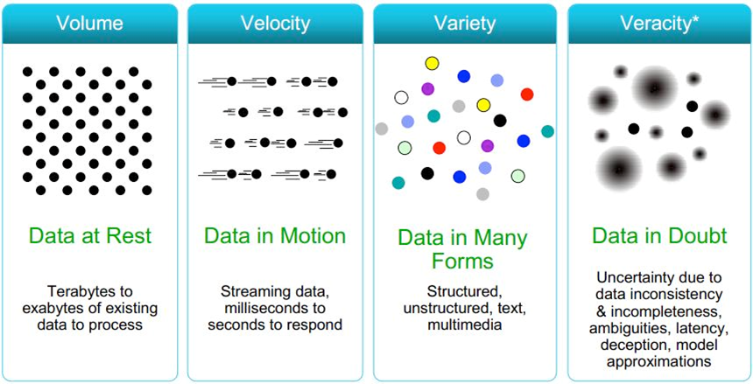
4Vs

Slide 4
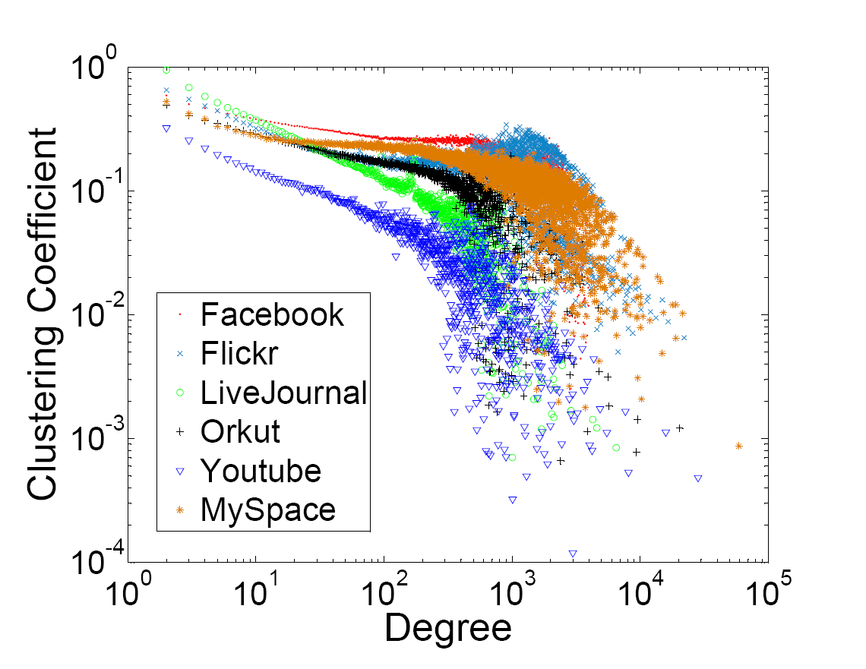
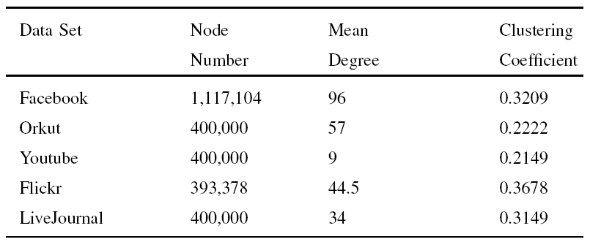
Unique Feature: Complex Interconnections

Slide 5

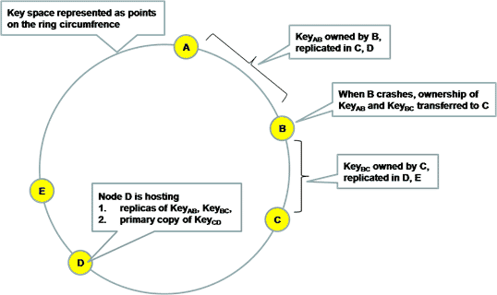


How to Scale – Consistent Hashing

Slide 6
Key-Value Stores in Social Network
Random partition is the de facto strategy
  Good load balance
  High scalability
  Low cost for server dynamics
Data features of social networks
  Complex inter-connection and interaction
  Relevant data – friends/followee
Problem
  Costly inter-server communications for friend scale operation

Slide 7
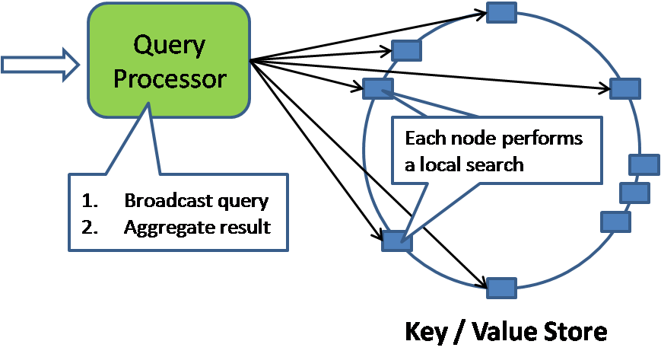
Example of Query Processing

Slide 8
Related Work
Understand system properties reflecting user behaviors to optimize design tradeoff
  Small-world, and scale-free of OSNs [Mislove et al. IMC'07]
  Log-normal degree distribution [Gomez et al. WWW’08]
Leverage the social graph
  Dynamic partition strategy with user-level replication to achieve local semantic with minimized replication cost [Pujol et al. SigComm’10]
Assumption: social links indicate real user interactions over OSNs
‹#›
Notes:
One billion monthly active users as of October 2012.
Approximately 81% of our monthly active users are outside the U.S. and Canada.
552 million daily active users on average in June 2012.
600 million monthly active users who used Facebook mobile products in September 2012.
‹#›

Slide 9
The Fact
Users in OSNs do not interact with most of their friends
  20% of friends account for 70% of all interactions in Facebook [Wilson et al. EuroSys’ 09]
  Social links and the social graphs they form not indicators of information flows between users
Graph Models for OSNs
  Social graph G = (E，V )
    V – set of participants
    E – set of social links
  Interaction graph G = (E，V )
    V – set of participants
    E’ – set of interaction links with interaction rate greater than a threshold ɵ = (n, t)
‹#›
Notes:
reciprocal

Slide 10
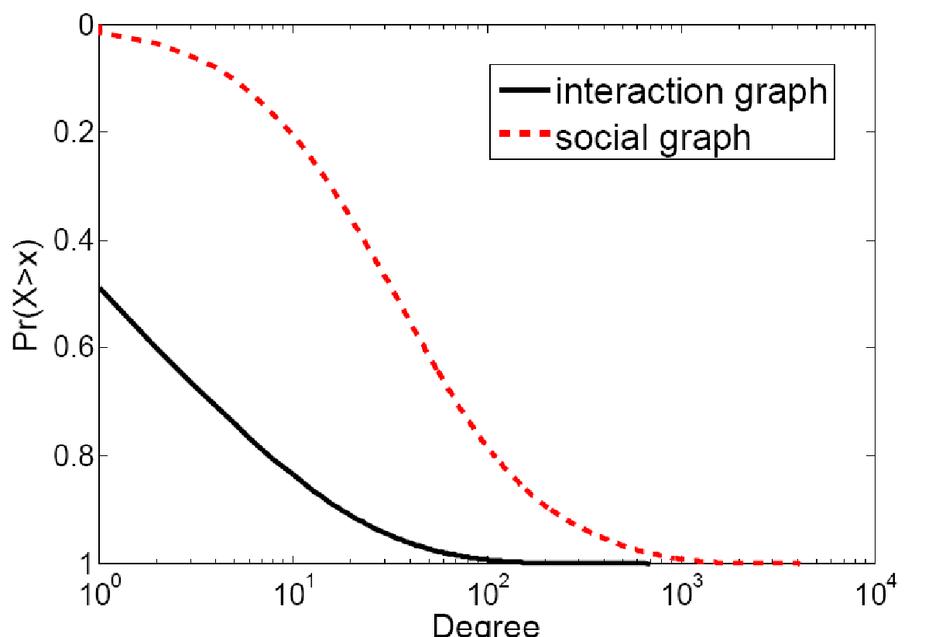
Degree
One order of magnitude lower average degree
‹#›

Slide 11
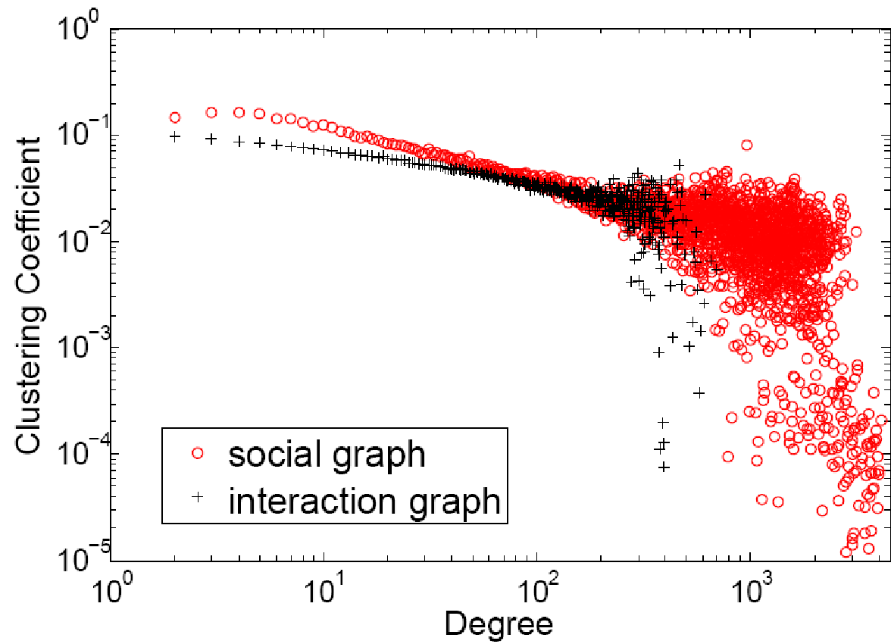
Cluster Coefficient
Lower Cluster Coefficient
‹#›

Slide 12
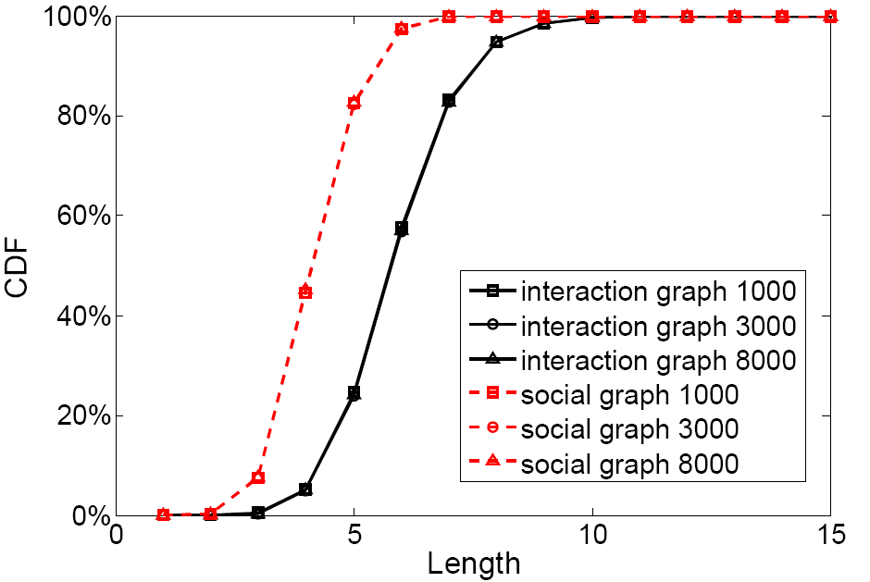
Degree of Separation
longer path length between pairs
‹#›

Slide 13
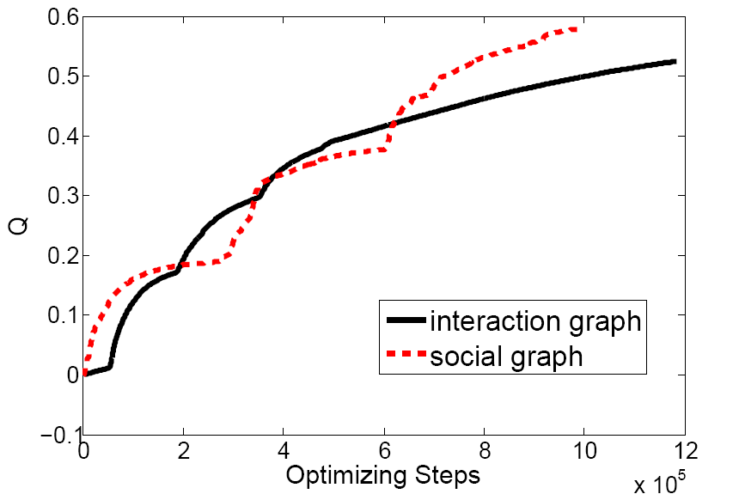
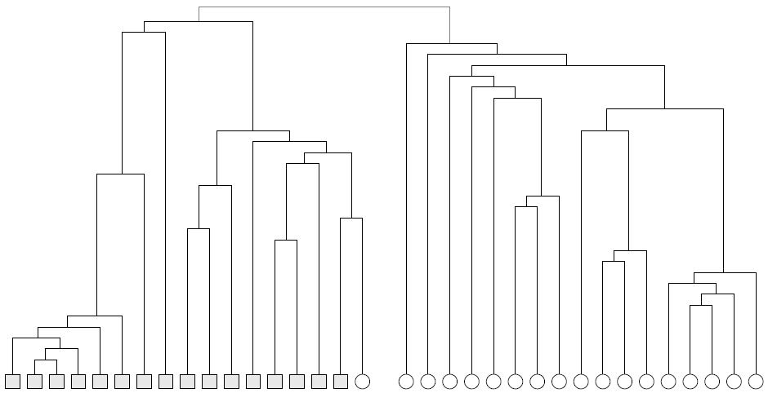
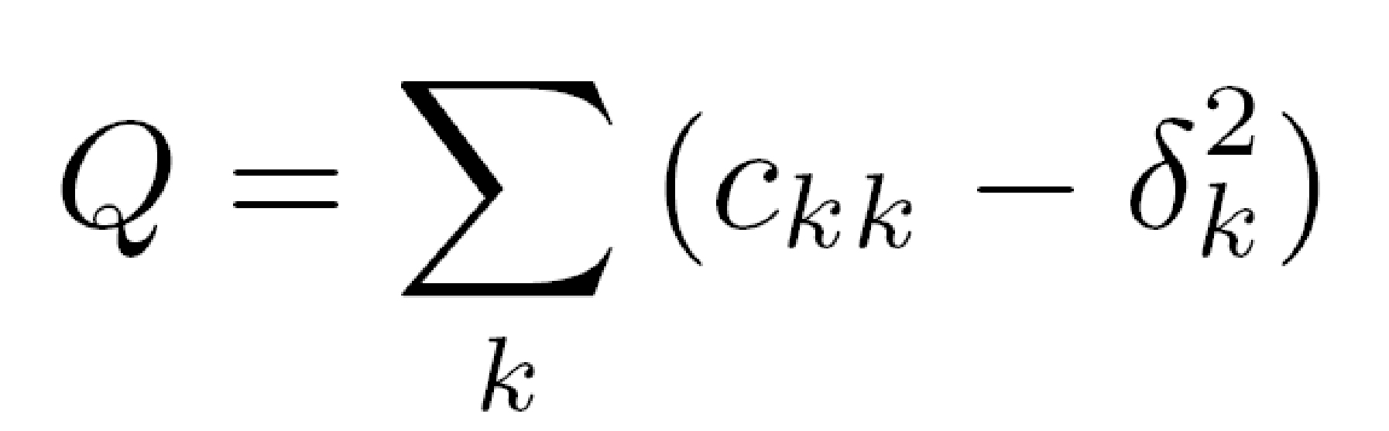
Locality – Community Structure

Slide 14
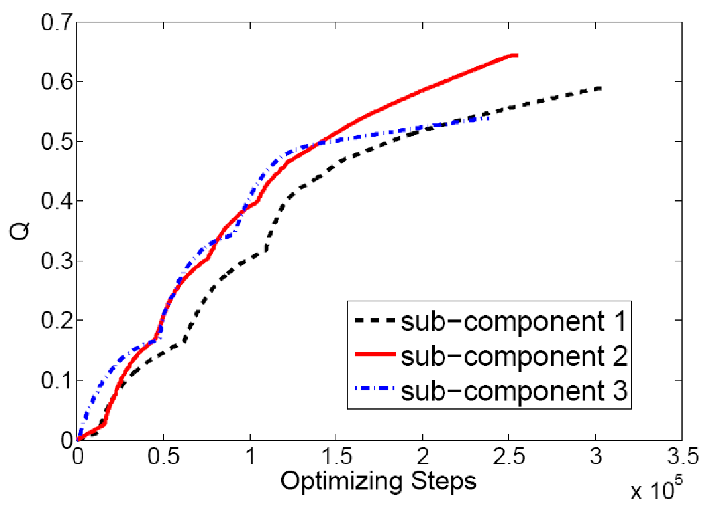
Sub-Component
Sub-Component also with distinct community structure
‹#›

Slide 15
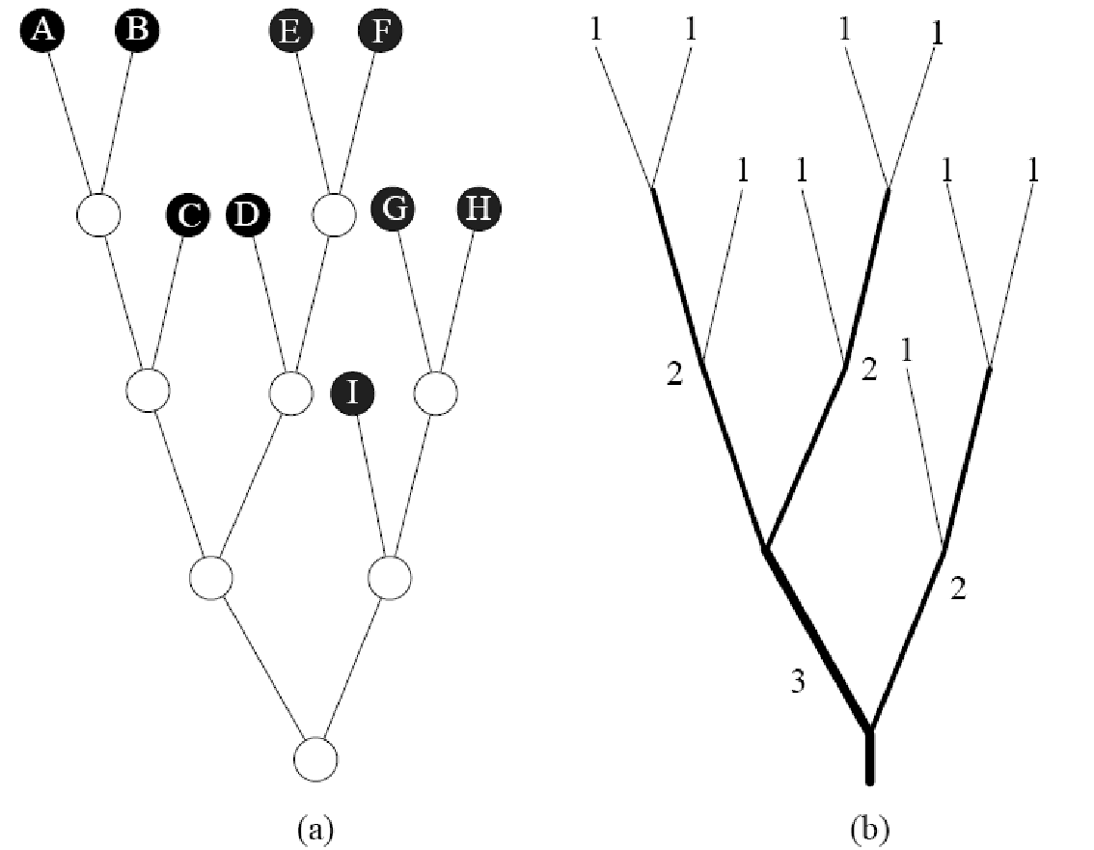
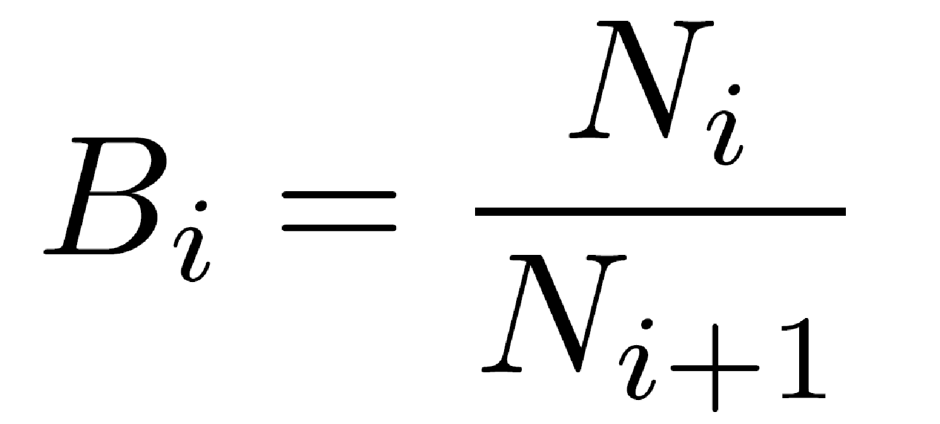
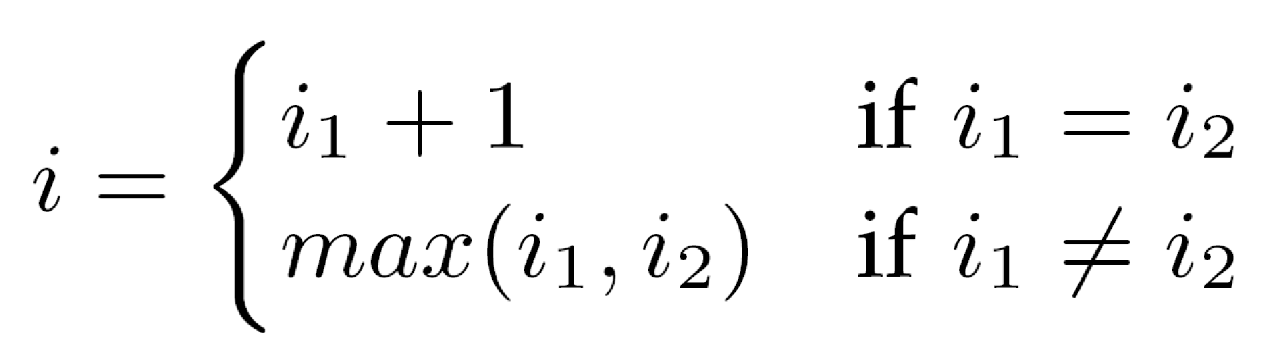
Analysis of Self-Similarity– HS Index

Slide 16
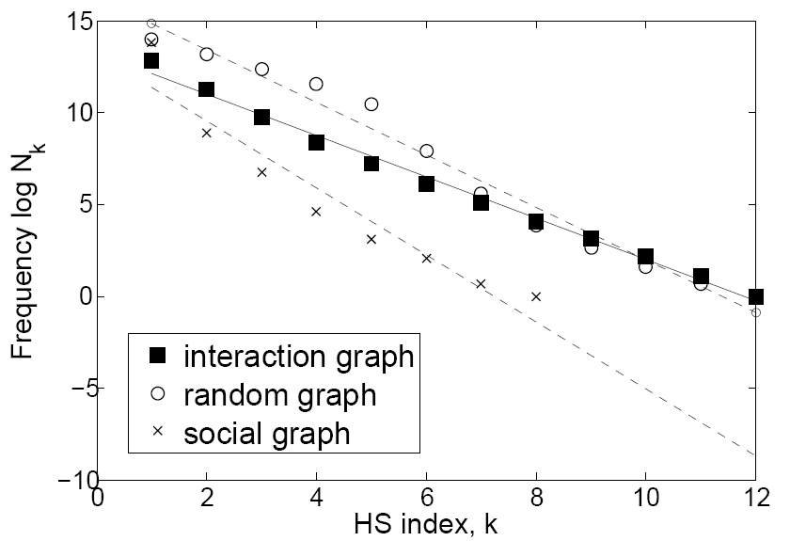
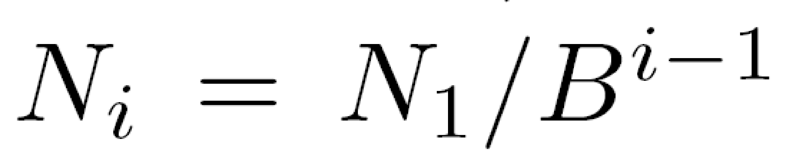
Formal Analysis – HS Index
fitting in good agreement with self-similarity

Slide 17
Data Placement Strategy
Initialize capacity for each server - K/N
Repeat until all the nodes stored
  Select the server S with the largest remaining capacity M
  Find the largest sub-tree from the interaction community tree with the number of leaves less than M
  Store all the leaves on the sub-tree in S
Dynamic adjustment
  Add/Remove user
  Add/Remove interaction link
  Add/Remove server

Slide 18
Evaluation
Facebook traces
  10 million users and 24 million interaction events
Physical data center network
  Fat-Tree with 8 to 3456 servers simulated using ns-2
Baseline schemes
  Cassandra with default Random-Partitioner option
  Little Engine [Pujol et al. SigComm’10]
Operation style
  Event-driven: wall post
  Push-on-change: user profile update
  Pull-on-demand: user login
Metrics
  Latency and Traffic
‹#›

Slide 19
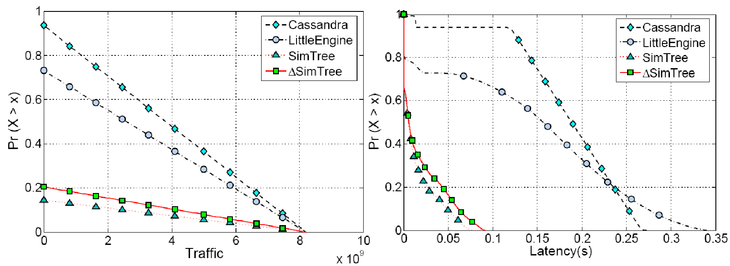
Wall Posts
84% traffic reduction
92% latency reduction
‹#›

Slide 20
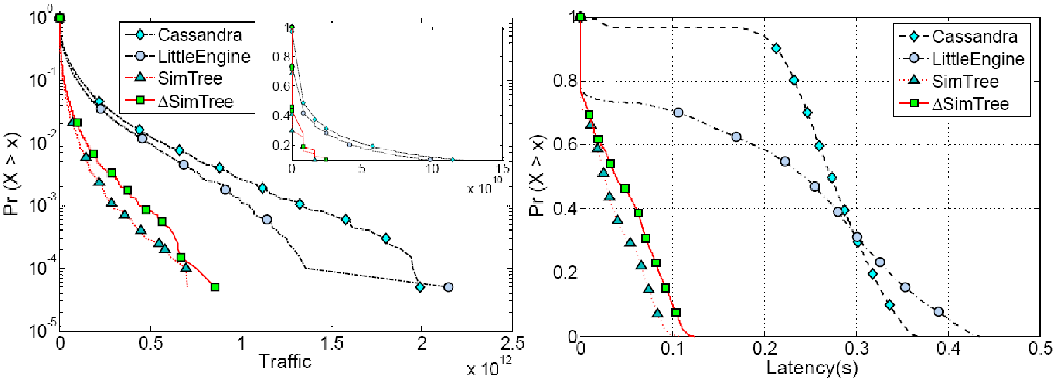
Profile update
80% traffic reduction
83% latency reduction
‹#›

Slide 21
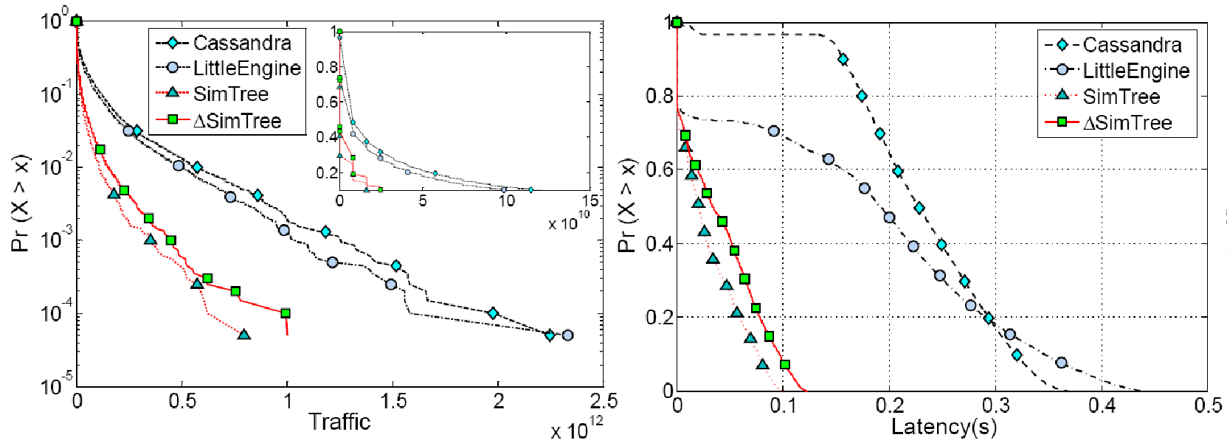
User Login
83% traffic reduction
87% latency reduction
‹#›

Slide 22
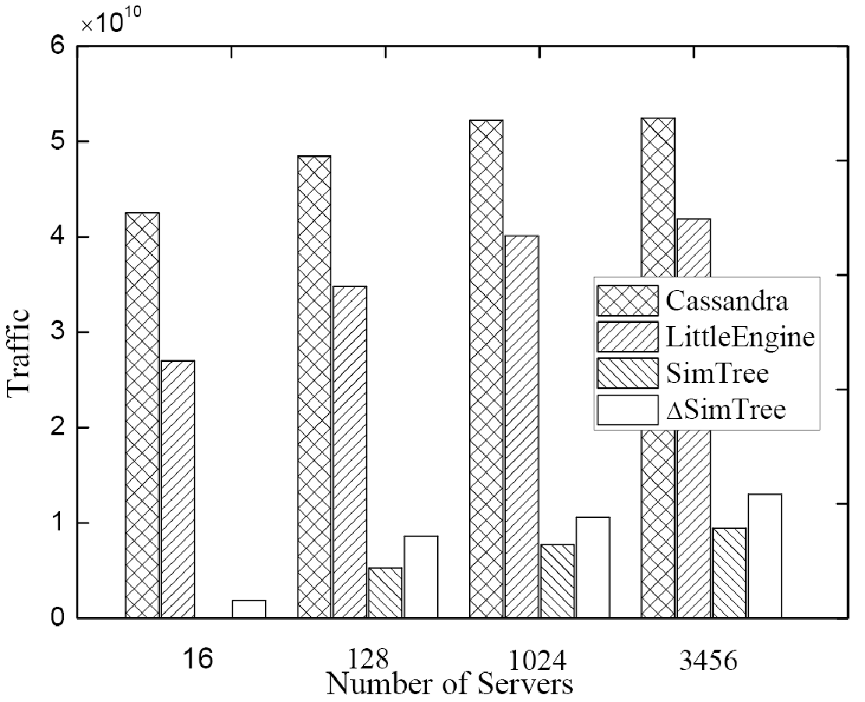
Overall Traffic
‹#›

Slide 23
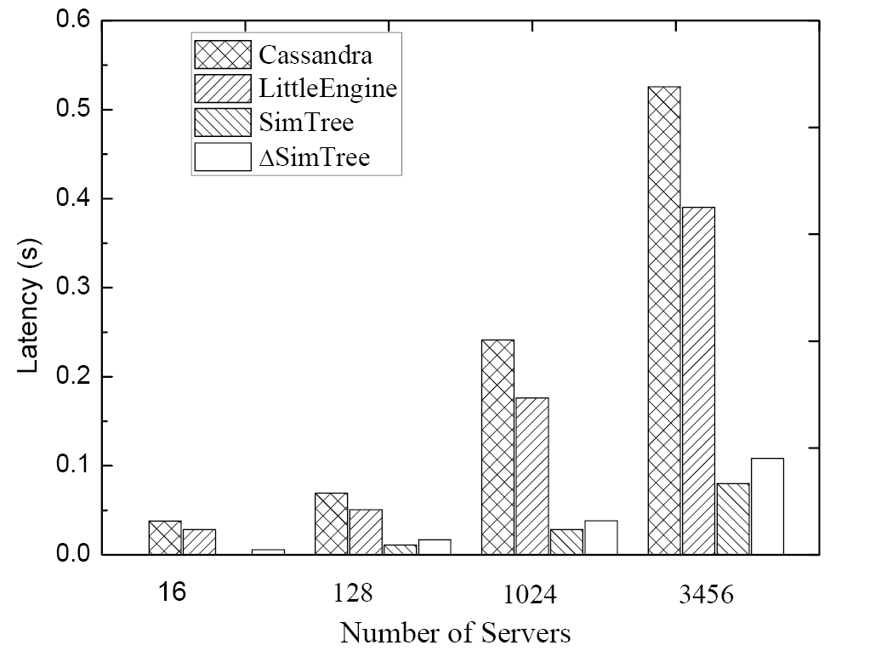
Overall Latency
‹#›

Slide 24
Conclusions
Identify self-similarity in the interactions of OSN using a large-scale Facebook logs
Novel data placement strategy for large-scale OSNs
  Avoid a significantly large amount of inter-server communications
  Achieve good load balance among servers across data center
‹#›

Slide 25
Thank you !
Questions?
‹#›

