Slide 1
脂蛋白研究进展
报告人 许荣仁

Slide 2
主要议程
聚类与临床指标
冠脉造影
下一步计划

Slide 3
聚类与临床指标
01

Slide 4
图像形式
9*236
脂质
9*131
蛋白质
9*105

Slide 5
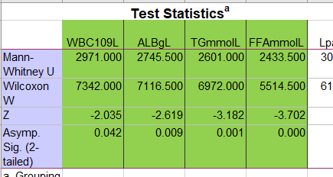
全部信息kmeans聚类
54% & 46%
WBC ALB TG FFA有统计学差异

Slide 6
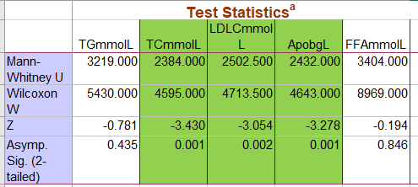
蛋白质信息kmeans聚类
61% & 39%
TC LDLC Apob有统计学差异

Slide 7
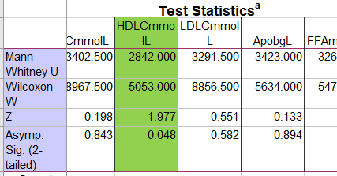
脂质信息kmeans聚类
61% & 39%
HDLC有统计学差异

Slide 8
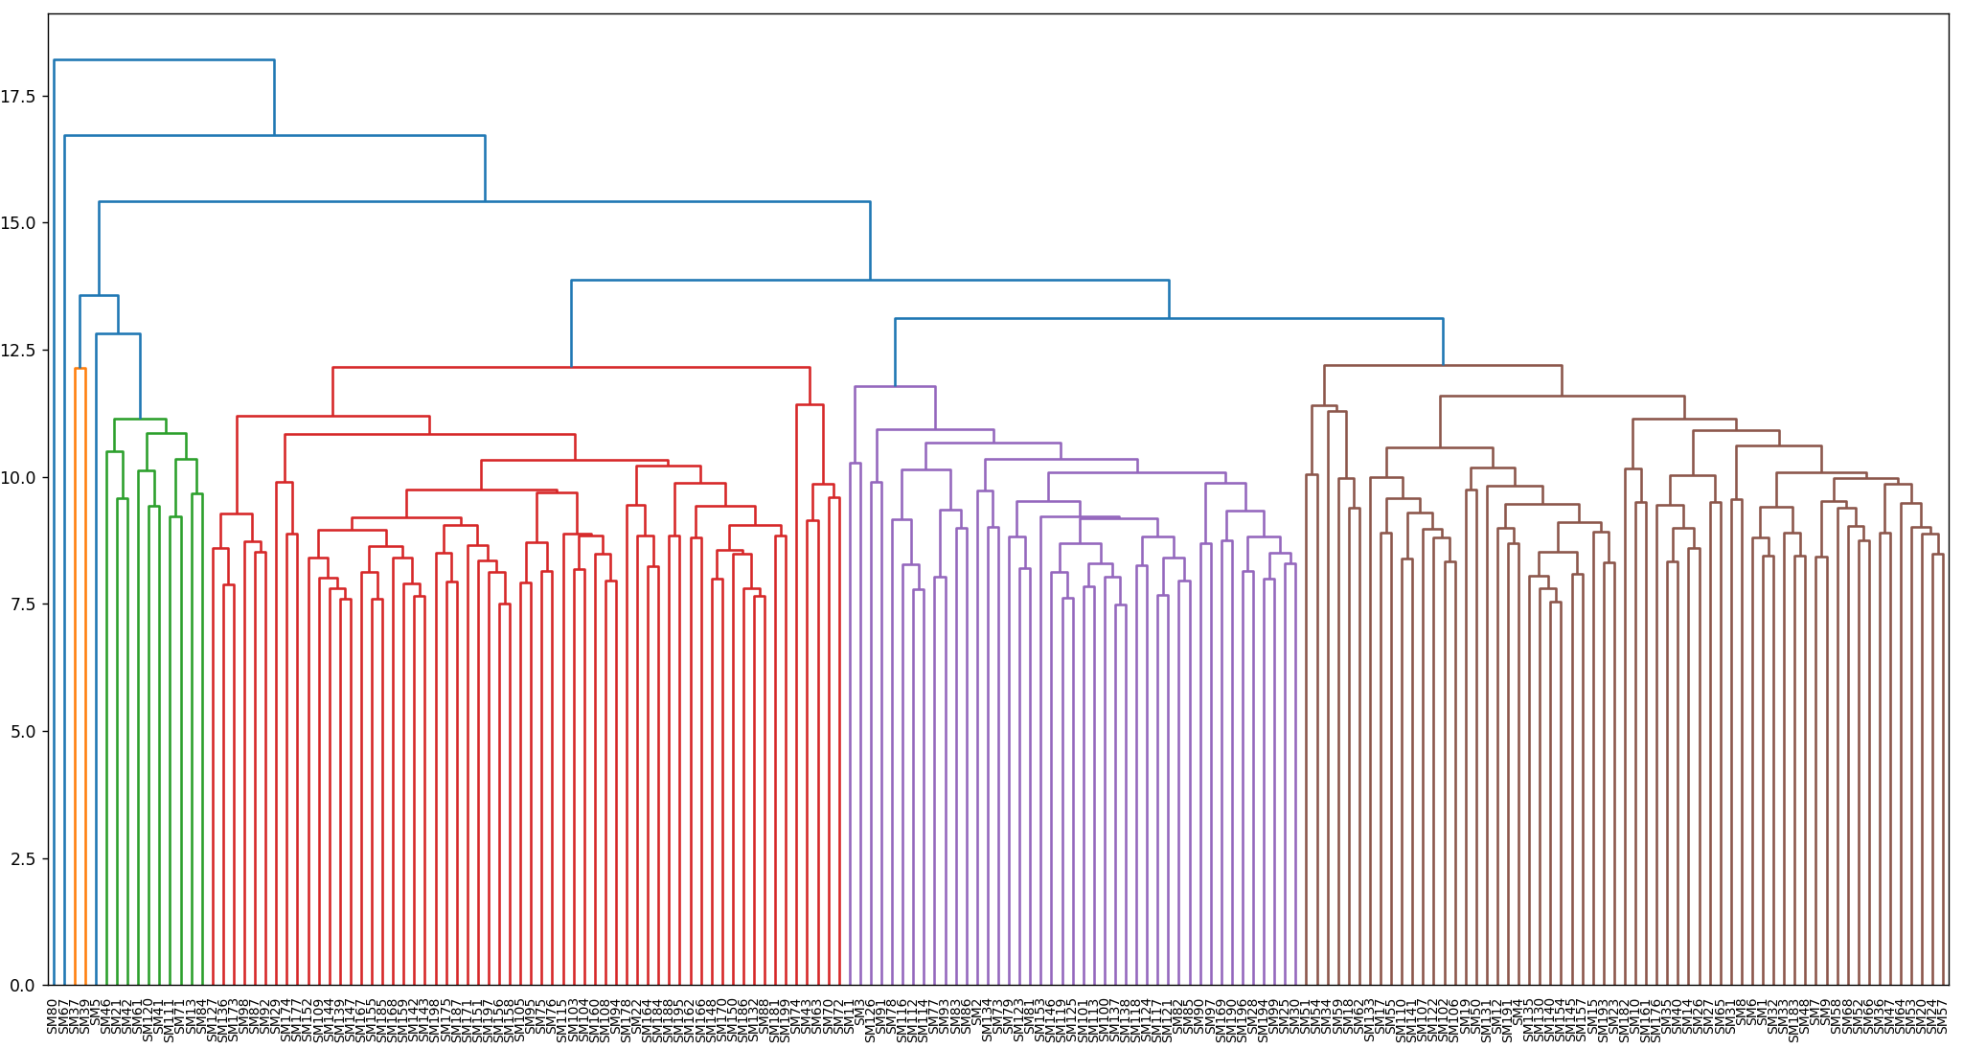
全部信息层次聚类

Slide 9
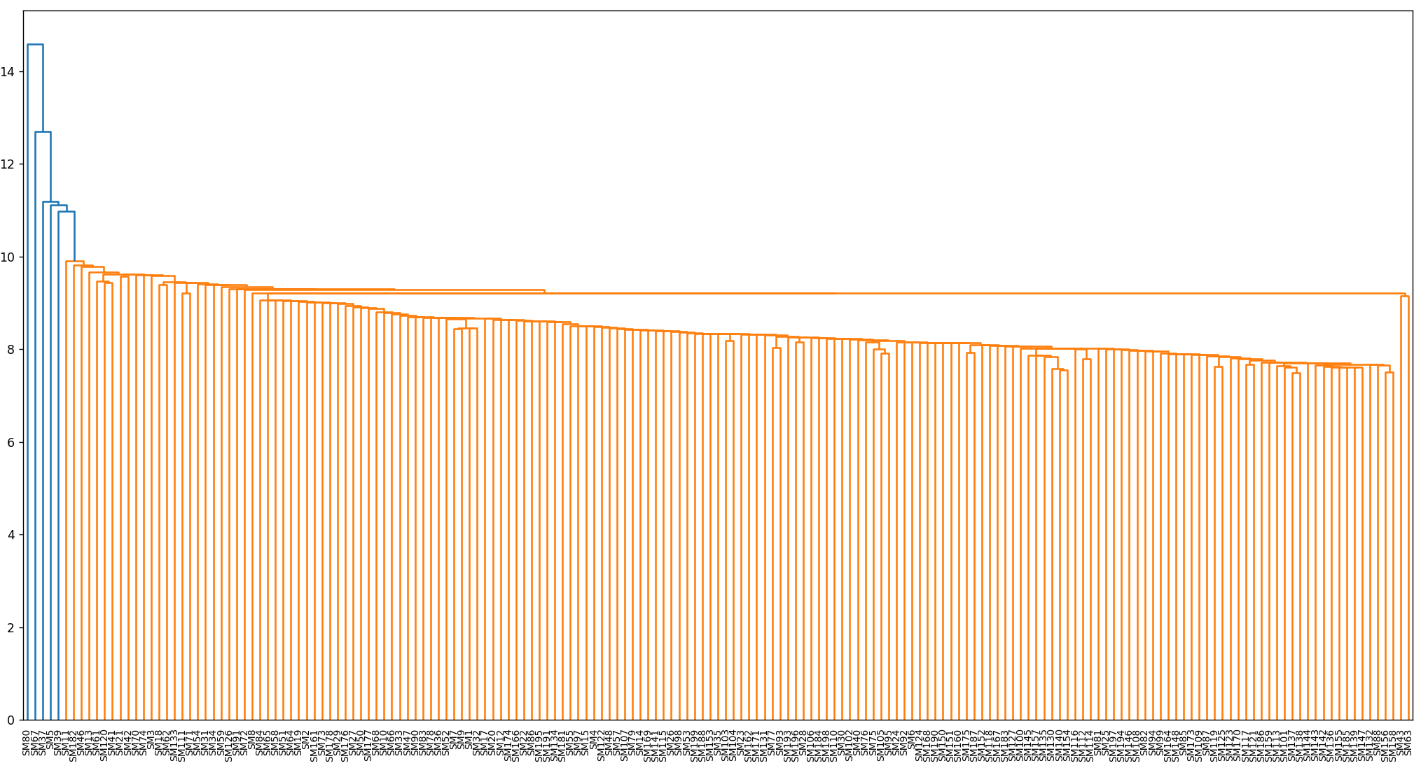
全部信息层次聚类

Slide 10
冠脉造影
02
Training and validation of a deep learning architecture for the automatic analysis of coronary angiography

Slide 11
Training and validation of a deep learning architecture for the automatic analysis of coronary angiography
冠状动脉段识别
病变形态识别
20,612张血管造影数据集
  13,373冠状动脉段
  7,239特殊病变形态

Slide 12
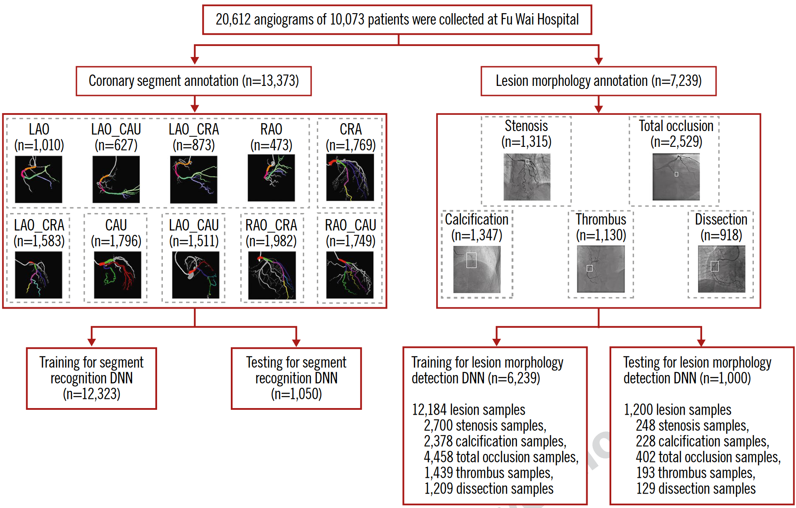
Training and validation of a deep learning architecture for the automatic analysis of coronary angiography

Slide 13
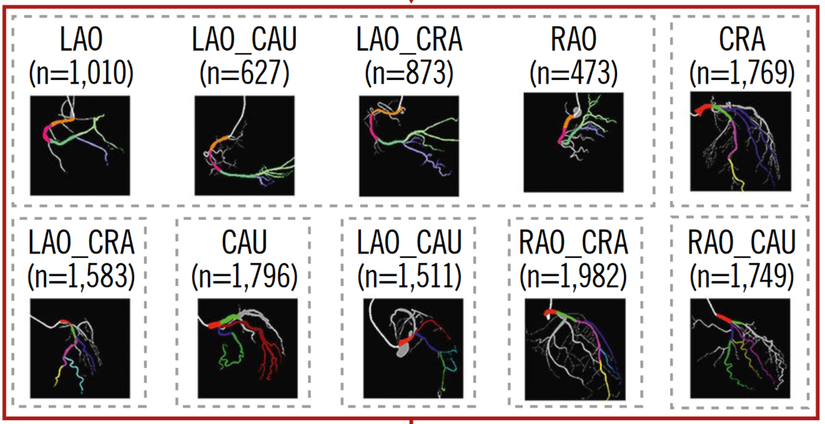
Training and validation of a deep learning architecture for the automatic analysis of coronary angiography

Slide 14
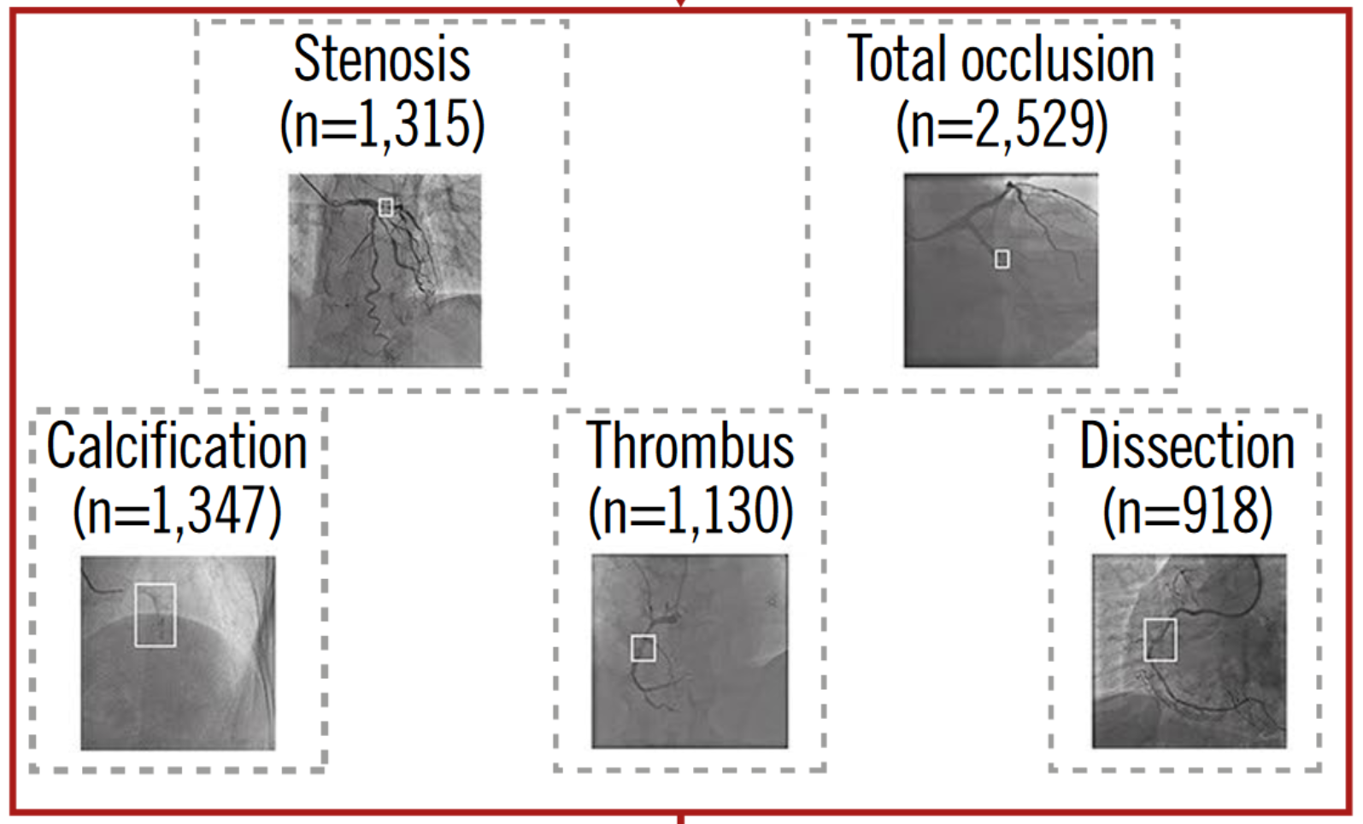
Training and validation of a deep learning architecture for the automatic analysis of coronary angiography

Slide 15
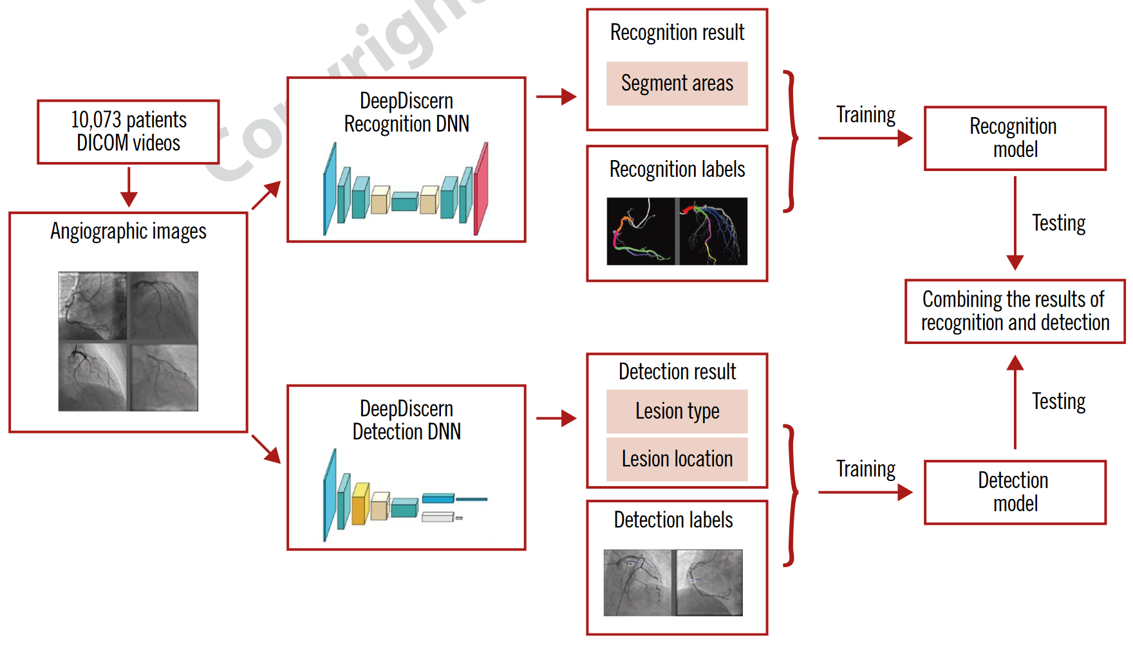
Training and validation of a deep learning architecture for the automatic analysis of coronary angiography

Slide 16
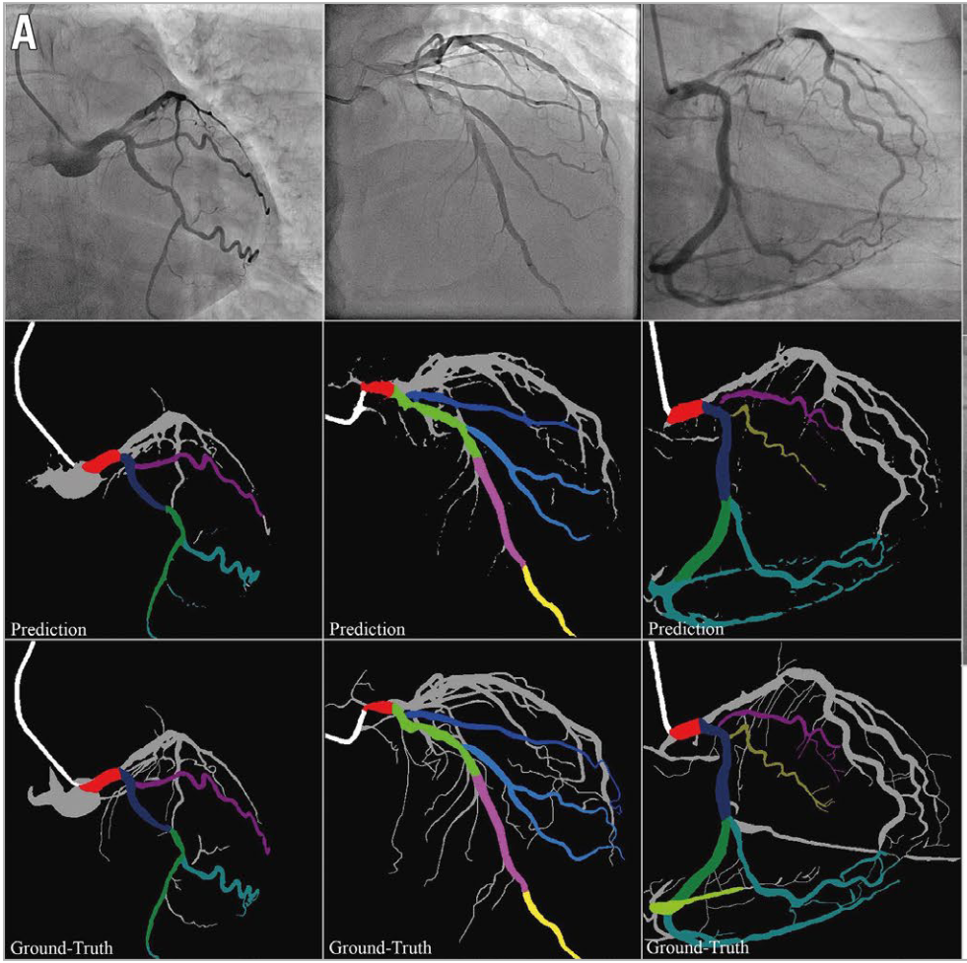
Training and validation of a deep learning architecture for the automatic analysis of coronary angiography
原始图像
识别结果
真实标注

Slide 17
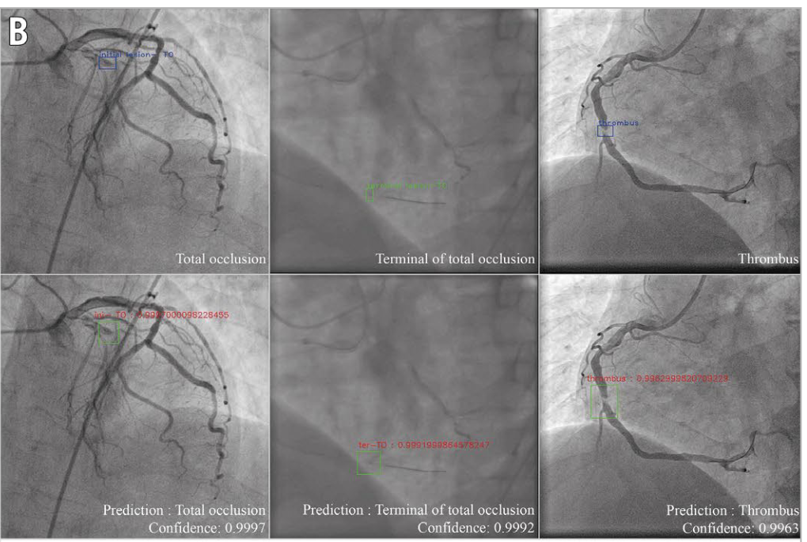
Training and validation of a deep learning architecture for the automatic analysis of coronary angiography
真实标注
病变识别结果

Slide 18
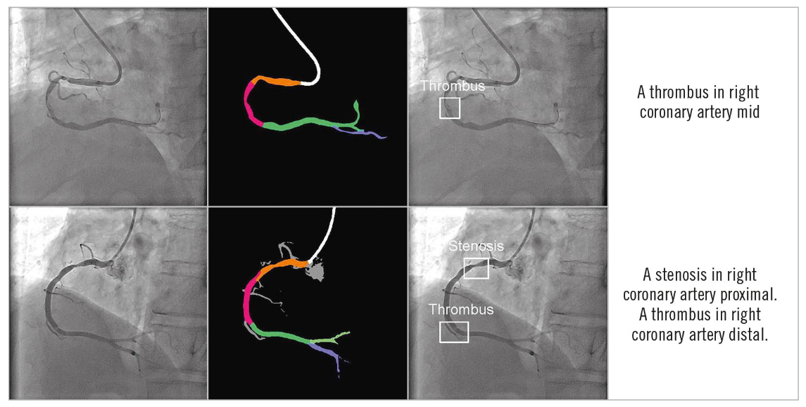
Training and validation of a deep learning architecture for the automatic analysis of coronary angiography
动脉段识别与病变检测的综合结果

Slide 19
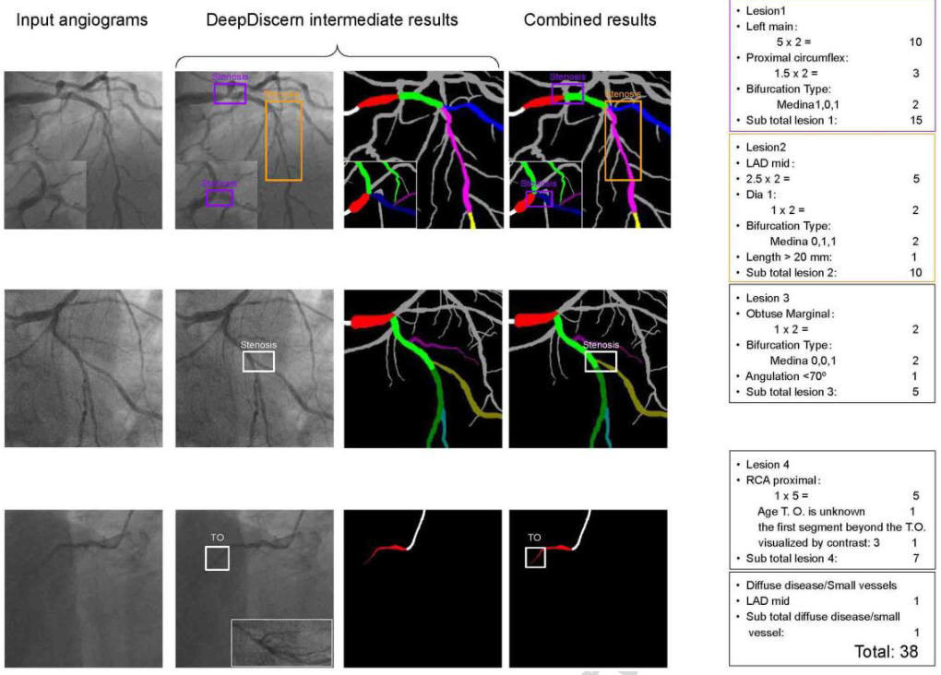
Training and validation of a deep learning architecture for the automatic analysis of coronary angiography
SYNTAX score

Slide 20
下一步计划
04

Slide 21
下一步计划
聚类与临床信息
小样本的方法

Slide 22
谢谢！

